Slide 1
ANOVA (ANalysis Of VAriance)

Slide 2
ANOVA (ANalysis Of VAriance)
Statistical method that is trying to explain the Variance in our DV(=target variable)

Slide 3
ANOVA (ANalysis Of VAriance)
Statistical method that is trying to explain the Variance in our IV(=target variable)
Example: Influence of smoking on aggressiveness.

Slide 4
ANOVA (ANalysis Of VAriance)
Statistical method that is trying to explain the Variance in our DV(=target variable)
Example: Influence of smoking on aggressiveness.
Smoking: Independent variable (that is trying to explain the variance)

Slide 5
ANOVA (ANalysis Of VAriance)
Statistical method that is trying to explain the Variance in our DV(=target variable)
Example: Influence of smoking on aggressiveness.
Smoking: Independent variable (that is trying to explain the variance)
Factors: The independent variables (=Smoking)

Slide 6
ANOVA (ANalysis Of VAriance)
Statistical method that is trying to explain the Variance in our DV(=target variable)
Example: Influence of smoking on aggressiveness.
Smoking: Independent variable (that is trying to explain the variance)
Factors: The independent variables (=Smoking)
Levels: characteristics of IV:
Non-smoker (1) weak smoker (2) strong smoker (3)

Slide 7
ANOVA (one-way vs. two-way)
Factors: Smoking and Age (One-way vs. Two way)
Levels:
Non-smoker, weak smoker, strong smoker (Smoking)
Younger, older (Age)

Slide 8
ANOVA (one-way vs. two-way)
Factors: Smoking and Age (One-way vs. Two way)
Levels:
Non-smoker, weak smoker, strong smoker (Smoking)
Younger, older (Age)
Different populations (according to levels) that we can draw samples from

Slide 9
Assumptions
Draw samples and do a test
Populations have a normal distribution & have the same variance
Samples are drawn randomly & independently

Slide 10
Plan of attack
Basics
One-way ANOVA
F-Distribution & How to interpret the result
Two-way ANOVA

Slide 11
ANOVA (One-way)
In one-way ANOVA we have only one factor (=Smoking)

Slide 12
ANOVA (One-way)
In one-way ANOVE we have only one factor (=Smoking)
Non-smoker | Weak smoker | Strong smoker
3 | 4 | 4
4 | 5 | 7
6 | 6 | 8
13 | 15 | 19

Slide 13
ANOVA (One-way)
Step 1: State the null hypothesis and alternative hypothesis
Non-smoker | Weak smoker | Strong smoker
3 | 4 | 4
4 | 5 | 7
6 | 6 | 8
13 | 15 | 19
Null hypothesis
Alternative hypothesis

Slide 14


ANOVA (One-way)
Step 1: State the null hypothesis and alternative hypothesis
Non-smoker | Weak smoker | Strong smoker
3 | 4 | 4
4 | 5 | 7
6 | 6 | 8
13 | 15 | 19
Null hypothesis
$$H_{0}:μ_{1}=μ_{2}=μ_{3}$$
Alternative hypothesis
$$H_{1}:μ_{1}≠μ_{2}≠μ_{3}$$

Slide 15



ANOVA (One-way)
Step 2: Calculate the variance between the samples
Non-smoker | Weak smoker | Strong smoker
4 | 5 | 5
5 | 6 | 7
6 | 7 | 9
15 | 18 | 21
Null hypothesis
$$H_{0}:μ_{1}=μ_{2}=μ_{3}$$
Alternative hypothesis
$$H_{1}:μ_{1}≠μ_{2}≠μ_{3}$$
a) Calculate the mean of the samples
$μ_{1}=$ $\frac{15}{3}$ = 5
$μ_{2}=$ $\frac{18}{3}$ = 6
$μ_{3}$ = $\frac{21}{3}$ = 7

Slide 16

ANOVA (One-way)
Step 2: Calculate the variance between the samples
Non-smoker | Weak smoker | Strong smoker
4 | 5 | 5
5 | 6 | 7
6 | 7 | 9
15 | 18 | 21
Null hypothesis
$$H_{0}:μ_{1}=μ_{2}=μ_{3}$$
Alternative hypothesis
$$H_{1}:μ_{1}≠μ_{2}≠μ_{3}$$
a) Calculate the mean of the samples
$μ_{1}=$ $\frac{15}{3}$ = 5
$μ_{2}=$ $\frac{18}{3}$ = 6
$μ_{3}$ = $\frac{21}{3}$ = 7
b) Calculate the average of the means
$μ_{1}=$ $\frac{μ_{1}+μ_{2}+μ_{3}}{3}$ $=$ $\frac{5+6+7}{3}$ = $\frac{18}{3}$ = 6

Slide 17



ANOVA (One-way)
Step 2: Calculate the variance between the samples
Non-smoker | Weak smoker | Strong smoker
4 | 5 | 5
5 | 6 | 7
6 | 7 | 9
15 | 18 | 21
Null hypothesis
$$H_{0}:μ_{1}=μ_{2}=μ_{3}$$
Alternative hypothesis
$$H_{1}:μ_{1}≠μ_{2}≠μ_{3}$$
$μ_{1}=$ $\frac{15}{3}$ = 5
$μ_{2}=$ $\frac{18}{3}$ = 6
$μ_{3}$ = $\frac{21}{3}$ = 7

Slide 18
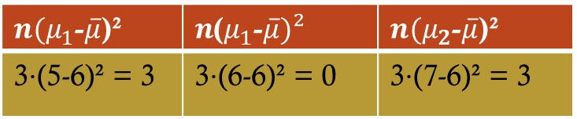







ANOVA (One-way)
Step 2: Calculate the variance between the samples
Null hypothesis
$$H_{0}:μ_{1}=μ_{2}=μ_{3}$$
Non-smoker | Weak smoker | Strong smoker
4 | 5 | 5
5 | 6 | 7
6 | 7 | 9
15 | 18 | 21
Alternative hypothesis
$$H_{1}:μ_{1}≠μ_{2}≠μ_{3}$$
a) Calculate the mean of the samples
$μ_{1}=$ $\frac{15}{3}$ = 5
$μ_{2}=$ $\frac{18}{3}$ = 6
$μ_{3}$ = $\frac{21}{3}$ = 7
b) Calculate the average of the means
$\overline{μ}=$ $\frac{μ_{1}+μ_{2}+μ_{3}}{3}$ $=$ $\frac{5+6+7}{3}$ = $\frac{18}{3}$ = 6
c) Difference between means of all combination of sample means
$n{(μ}_{1}$-$\overline{μ}$)² | $n$($μ_{1}$-$\overline{μ})²$ | $n{(μ}_{2}$-$\overline{μ}$)²
3$⋅$(5-6)² = 3 | 3$⋅$(6-6)² = 0 | 3$⋅$(7-6)² = 3
$$Σ:6$$

Slide 19
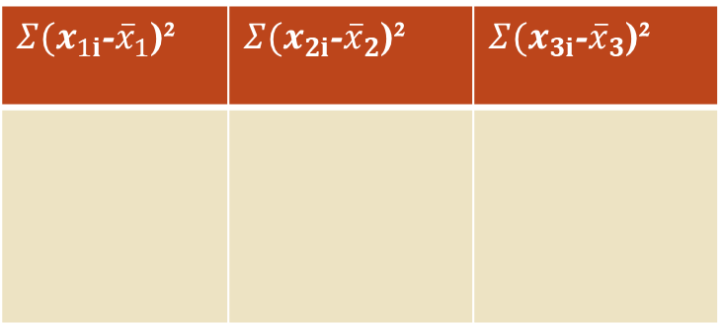
ANOVA (One-way)
Step 3: Calculate the variance within the samples
$Σ{(x}_{1i}$-${\overline{x}}_{1}$)² | $Σ{(x}_{2i}$-${\overline{x}}_{2}$)² | $Σ{(x}_{3i}$-${\overline{x}}_{3}$)²
Non-smoker | Weak smoker | Strong smoker
4 | 5 | 5
5 | 6 | 7
6 | 7 | 9
15 | 18 | 21

Slide 20
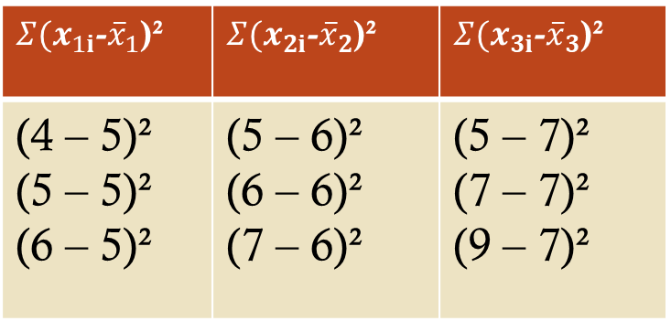
ANOVA (One-way)
Step 3: Calculate the variance within the samples
Non-smoker | Weak smoker | Strong smoker
4 | 5 | 5
5 | 6 | 7
6 | 7 | 9
15 | 18 | 21
$Σ{(x}_{1i}$-${\overline{x}}_{1}$)² | $Σ{(x}_{2i}$-${\overline{x}}_{2}$)² | $Σ{(x}_{3i}$-${\overline{x}}_{3}$)²
(4 – 5)² (5 – 5)² (6 – 5)² | (5 – 6)² (6 – 6)² (7 – 6)² | (5 – 7)² (7 – 7)² (9 – 7)²
b) Calculate the average of the means

Slide 21
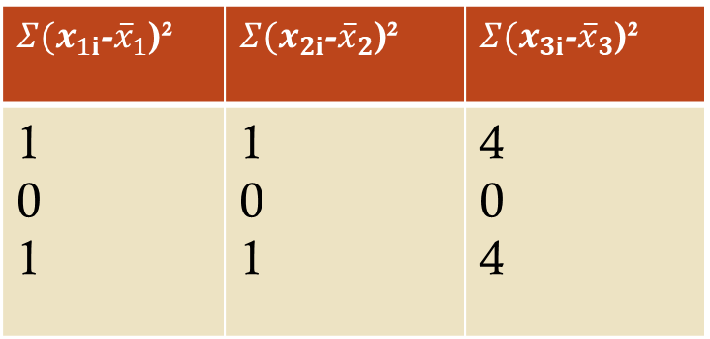
ANOVA (One-way)
Step 3: Calculate the variance within the samples
Non-smoker | Weak smoker | Strong smoker
4 | 5 | 5
5 | 6 | 7
6 | 7 | 9
15 | 18 | 21
$Σ{(x}_{1i}$-${\overline{x}}_{1}$)² | $Σ{(x}_{2i}$-${\overline{x}}_{2}$)² | $Σ{(x}_{3i}$-${\overline{x}}_{3}$)²
1 0 1 | 1 0 1 | 4 0 4
b) Calculate the average of the means

Slide 22

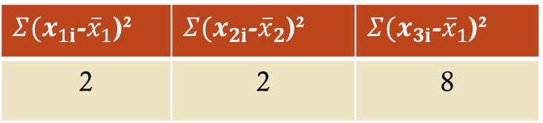
ANOVA (One-way)
Step 3: Calculate the variance within the samples
$Σ{(x}_{1i}$-${\overline{x}}_{1}$)² | $Σ{(x}_{2i}$-${\overline{x}}_{2}$)² | $Σ{(x}_{3i}$-${\overline{x}}_{1}$)²
2 | 2 | 8
Non-smoker | Weak smoker | Strong smoker
4 | 5 | 5
5 | 6 | 7
6 | 7 | 9
15 | 18 | 21
$Σ$ = 12

Slide 23
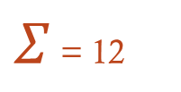
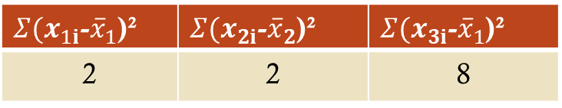
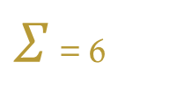
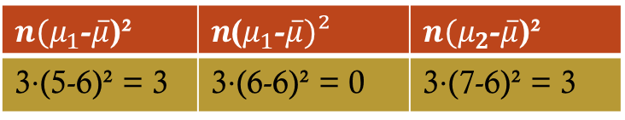
ANOVA (One-way)
Step 4: Calculate the f-ratio
$Σ{(x}_{1i}$-${\overline{x}}_{1}$)² | $Σ{(x}_{2i}$-${\overline{x}}_{2}$)² | $Σ{(x}_{3i}$-${\overline{x}}_{1}$)²
2 | 2 | 8
$Σ$ = 12
Non-smoker | Weak smoker | Strong smoker
4 | 5 | 5
5 | 6 | 7
6 | 7 | 9
$n{(μ}_{1}$-$\overline{μ}$)² | $n$($μ_{1}$-$\overline{μ})²$ | $n{(μ}_{2}$-$\overline{μ}$)²
3$⋅$(5-6)² = 3 | 3$⋅$(6-6)² = 0 | 3$⋅$(7-6)² = 3
$Σ$ = 6

Slide 24
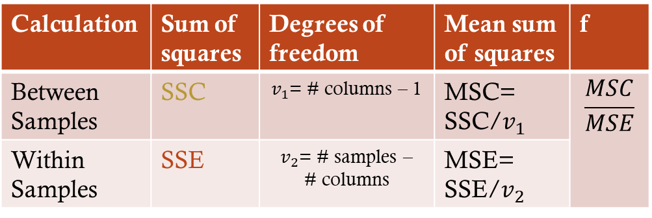
ANOVA (One-way)
Step 4: Calculate the f-ratio
$Σ{(x}_{1i}$-${\overline{x}}_{1}$)² | $Σ{(x}_{2i}$-${\overline{x}}_{2}$)² | $Σ{(x}_{3i}$-${\overline{x}}_{1}$)²
2 | 2 | 8
$Σ$ = 12
Non-smoker | Weak smoker | Strong smoker
4 | 5 | 5
5 | 6 | 7
6 | 7 | 9
$n{(μ}_{1}$-$\overline{μ}$)² | $n$($μ_{1}$-$\overline{μ})²$ | $n{(μ}_{2}$-$\overline{μ}$)²
3$⋅$(5-6)² = 3 | 3$⋅$(6-6)² = 0 | 3$⋅$(7-6)² = 3
$Σ$ = 6
Calculate the ratio of f
SSC = Sum of
squares (columns)
Calculation | Sum of squares | Degrees of freedom | Mean sum of squares | f
Between Samples | SSC | $v_{1}$= # columns – 1 | MSC= SSC/$v_{1}$ | $$\frac{MSC}{MSE}$$
Within Samples | SSE | $v_{2}$= # samples – # columns | MSE= SSE/$v_{2}$
SSE = Sum of
squares (rows)
MSC = Mean sum of
squares (betw. samples)
MSE = Mean sum of
squares (within sample)

Slide 25
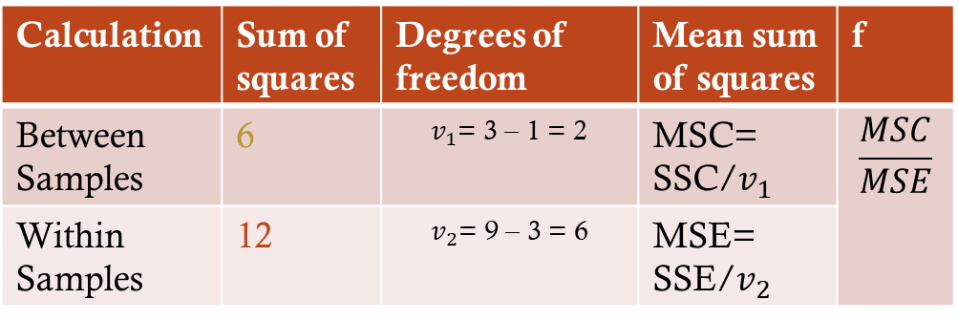
ANOVA (One-way)
Step 4: Calculate the f-ratio
$Σ{(x}_{1i}$-${\overline{x}}_{1}$)² | $Σ{(x}_{2i}$-${\overline{x}}_{2}$)² | $Σ{(x}_{3i}$-${\overline{x}}_{1}$)²
2 | 2 | 8
$Σ$ = 12
Non-smoker | Weak smoker | Strong smoker
4 | 5 | 5
5 | 6 | 7
6 | 7 | 9
$n{(μ}_{1}$-$\overline{μ}$)² | $n$($μ_{1}$-$\overline{μ})²$ | $n{(μ}_{2}$-$\overline{μ}$)²
3$⋅$(5-6)² = 3 | 3$⋅$(6-6)² = 0 | 3$⋅$(7-6)² = 3
$Σ$ = 6
Calculate the ratio of f
SSC = Sum of
squares (columns)
Calculation | Sum of squares | Degrees of freedom | Mean sum of squares | f
Between Samples | 6 | $v_{1}$= 3 – 1 = 2 | MSC= SSC/$v_{1}$ | $$\frac{MSC}{MSE}$$
Within Samples | 12 | $v_{2}$= 9 – 3 = 6 | MSE= SSE/$v_{2}$
SSE = Sum of
squares (rows)
MSC = Mean sum of
squares (betw. samples)
MSE = Mean sum of
squares (within sample)

Slide 26
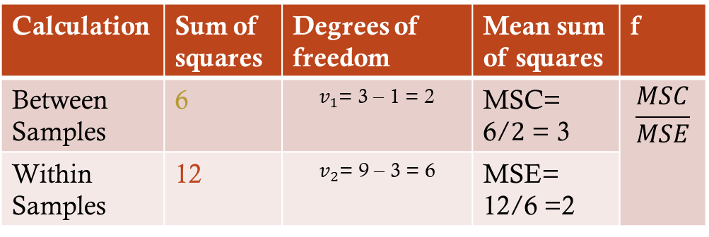
ANOVA (One-way)
Step 4: Calculate the f-ratio
$Σ{(x}_{1i}$-${\overline{x}}_{1}$)² | $Σ{(x}_{2i}$-${\overline{x}}_{2}$)² | $Σ{(x}_{3i}$-${\overline{x}}_{1}$)²
2 | 2 | 8
$Σ$ = 12
Non-smoker | Weak smoker | Strong smoker
4 | 5 | 5
5 | 6 | 7
6 | 7 | 9
$n{(μ}_{1}$-$\overline{μ}$)² | $n$($μ_{1}$-$\overline{μ})²$ | $n{(μ}_{2}$-$\overline{μ}$)²
3$⋅$(5-6)² = 3 | 3$⋅$(6-6)² = 0 | 3$⋅$(7-6)² = 3
$Σ$ = 6
Calculate the ratio of f
SSC = Sum of
squares (columns)
Calculation | Sum of squares | Degrees of freedom | Mean sum of squares | f
Between Samples | 6 | $v_{1}$= 3 – 1 = 2 | MSC= 6/$2$ = 3 | $$\frac{MSC}{MSE}$$
Within Samples | 12 | $v_{2}$= 9 – 3 = 6 | MSE= 12/6 =2
SSE = Sum of
squares (rows)
MSC = Mean sum of
squares (betw. samples)
MSE = Mean sum of
squares (within sample)

Slide 27
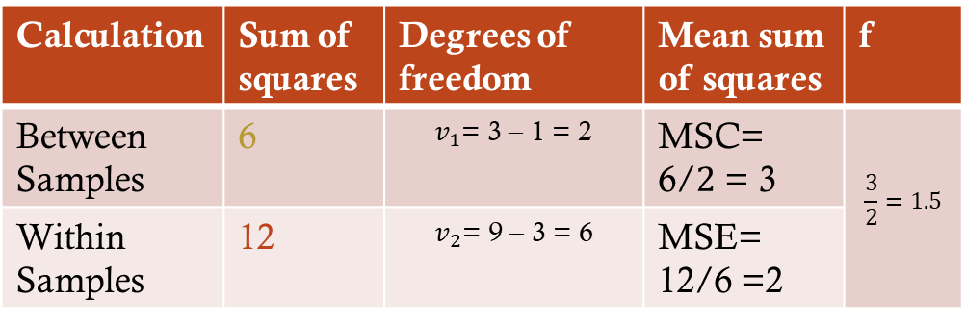
ANOVA (One-way)
Step 4: Calculate the f-ratio
$Σ{(x}_{1i}$-${\overline{x}}_{1}$)² | $Σ{(x}_{2i}$-${\overline{x}}_{2}$)² | $Σ{(x}_{3i}$-${\overline{x}}_{1}$)²
2 | 2 | 8
$Σ$ = 12
Non-smoker | Weak smoker | Strong smoker
4 | 5 | 5
5 | 6 | 7
6 | 7 | 9
$n{(μ}_{1}$-$\overline{μ}$)² | $n$($μ_{1}$-$\overline{μ})²$ | $n{(μ}_{2}$-$\overline{μ}$)²
3$⋅$(5-6)² = 3 | 3$⋅$(6-6)² = 0 | 3$⋅$(7-6)² = 3
$Σ$ = 6
Calculate the ratio of f
SSC = Sum of
squares (columns)
Calculation | Sum of squares | Degrees of freedom | Mean sum of squares | f
Between Samples | 6 | $v_{1}$= 3 – 1 = 2 | MSC= 6/$2$ = 3 | $$\frac{3}{2}=1.5$$
Within Samples | 12 | $v_{2}$= 9 – 3 = 6 | MSE= 12/6 =2
SSE = Sum of
squares (rows)
MSC = Mean sum of
squares (betw. samples)
MSE = Mean sum of
squares (within sample)

Slide 28
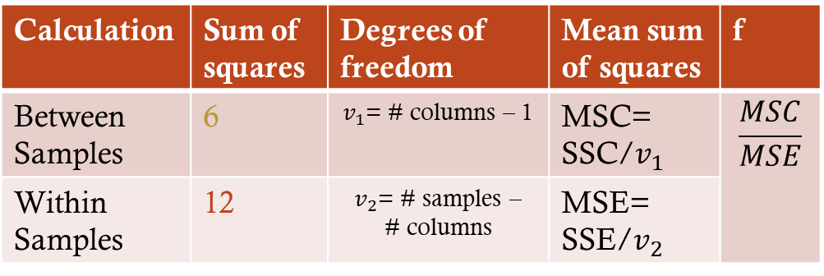
ANOVA (One-way)
Step 4: Calculate the f-ratio
$Σ{(x}_{1i}$-${\overline{x}}_{1}$)² | $Σ{(x}_{2i}$-${\overline{x}}_{2}$)² | $Σ{(x}_{3i}$-${\overline{x}}_{1}$)²
2 | 2 | 8
$Σ$ = 12
Non-smoker | Weak smoker | Strong smoker
4 | 5 | 5
5 | 6 | 7
6 | 7 | 9
$n{(μ}_{1}$-$\overline{μ}$)² | $n$($μ_{1}$-$\overline{μ})²$ | $n{(μ}_{2}$-$\overline{μ}$)²
3$⋅$(5-6)² = 3 | 3$⋅$(6-6)² = 0 | 3$⋅$(7-6)² = 3
$Σ$ = 6
Calculate the ratio of f
SSC = Sum of
squares (columns)
Calculation | Sum of squares | Degrees of freedom | Mean sum of squares | f
Between Samples | 6 | $v_{1}$= # columns – 1 | MSC= SSC/$v_{1}$ | $$\frac{MSC}{MSE}$$
Within Samples | 12 | $v_{2}$= # samples – # columns | MSE= SSE/$v_{2}$
SSE = Sum of
squares (rows)
MSC = Mean sum of
squares (betw. samples)
MSE = Mean sum of
squares (within sample)

Slide 29
ANOVA (One-way)
Step 4: Calculate the f-ratio
$Σ{(x}_{1i}$-${\overline{x}}_{1}$)² | $Σ{(x}_{2i}$-${\overline{x}}_{2}$)² | $Σ{(x}_{3i}$-${\overline{x}}_{1}$)²
2 | 2 | 8
$Σ$ = 12
Non-smoker | Weak smoker | Strong smoker
4 | 5 | 5
5 | 6 | 7
6 | 7 | 9
$n{(μ}_{1}$-$\overline{μ}$)² | $n$($μ_{1}$-$\overline{μ})²$ | $n{(μ}_{2}$-$\overline{μ}$)²
3$⋅$(5-6)² = 3 | 3$⋅$(6-6)² = 0 | 3$⋅$(7-6)² = 3
$Σ$ = 6
Calculate the ratio of f
SSC = Sum of
squares (columns)
Calculation | Sum of squares | Degrees of freedom | Mean sum of squares | f
Between Samples | 6 | $v_{1}$= 3 – 1 = 2 | MSC= SSC/$v_{1}$ | $$\frac{MSC}{MSE}$$
Within Samples | 12 | $v_{2}$= 9 – 3 = 6 | MSE= SSE/$v_{2}$
SSE = Sum of
squares (rows)
MSC = Mean sum of
squares (betw. samples)
MSE = Mean sum of
squares (within sample)

Slide 30
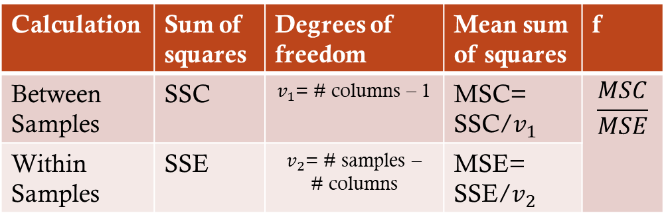
ANOVA (One-way)
Step 4: Calculate the f-ratio
$Σ{(x}_{1i}$-${\overline{x}}_{1}$)² | $Σ{(x}_{2i}$-${\overline{x}}_{2}$)² | $Σ{(x}_{3i}$-${\overline{x}}_{1}$)²
2 | 2 | 8
Non-smoker | Weak smoker | Strong smoker
4 | 5 | 5
5 | 6 | 7
6 | 7 | 9
$Σ$ = 12
Calculate the ratio of f
SSC = Sum of
squares (columns)
Calculation | Sum of squares | Degrees of freedom | Mean sum of squares | f
Between Samples | SSC | $v_{1}$= # columns – 1 | MSC= SSC/$v_{1}$ | $$\frac{MSC}{MSE}$$
Within Samples | SSE | $v_{2}$= # samples – # columns | MSE= SSE/$v_{2}$
SSE = Sum of
squares (rows)
MSC = Mean sum of
squares (betw. samples)
MSE = Mean sum of
squares (within sample)

Slide 31
ANOVA (One-way)
Step 5: Compare the calculated f-ratio with table value
$Σ{(x}_{1i}$-${\overline{x}}_{1}$)² | $Σ{(x}_{2i}$-${\overline{x}}_{2}$)² | $Σ{(x}_{3i}$-${\overline{x}}_{1}$)²
2 | 2 | 8
Non-smoker | Weak smoker | Strong smoker
4 | 5 | 5
5 | 6 | 7
6 | 7 | 9
$Σ$ = 12
Calculate the ratio of f
SSC = Sum of
squares (columns)
Calculation | Sum of squares | Degrees of freedom | Mean sum of squares | f
Between Samples | SSC | $v_{1}$= # columns – 1 | MSC= SSC/$v_{1}$ | $$\frac{MSC}{MSE}$$
Within Samples | SSE | $v_{2}$= # samples – # columns | MSE= SSE/$v_{2}$
SSE = Sum of
squares (rows)
MSC = Mean sum of
squares (betw. samples)
MSE = Mean sum of
squares (within sample)

Slide 33
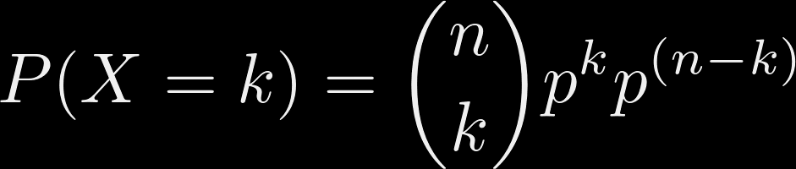

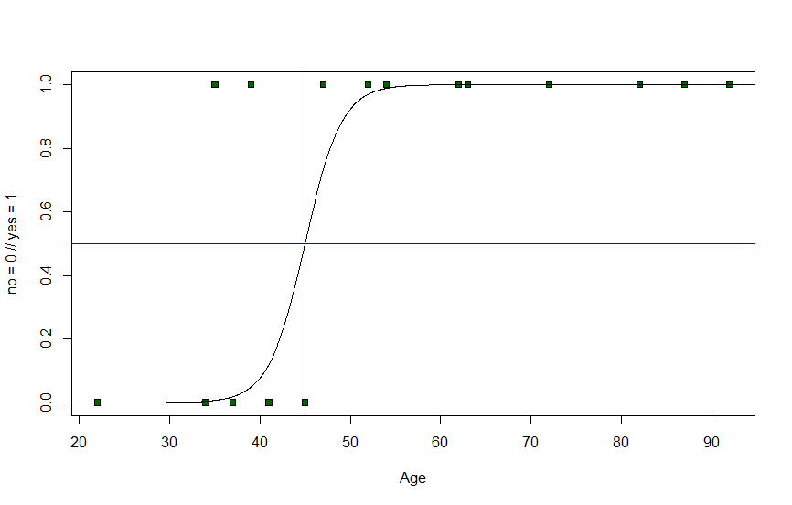
F-Distribution

Slide 34
F-Distribution
Fisher-Snedecor distribution

Slide 35
F-Distribution
Used in the F-test to determine if we reject $H_{0}$

Slide 36
F-Distribution
F-ratio

Slide 37
F-Distribution
F-ratio

Slide 38
F-Distribution
critical value
F-ratio

Slide 39
F-Distribution
critical value
F-ratio
<
No significance
Don't reject $H_{0}$
critical value
F-ratio

Slide 40
F-Distribution
critical value
F-ratio
>
Significance
Reject $H_{0}$
F-ratio
critical value

Slide 41
F-Distribution
critical value
F-ratio

Slide 42
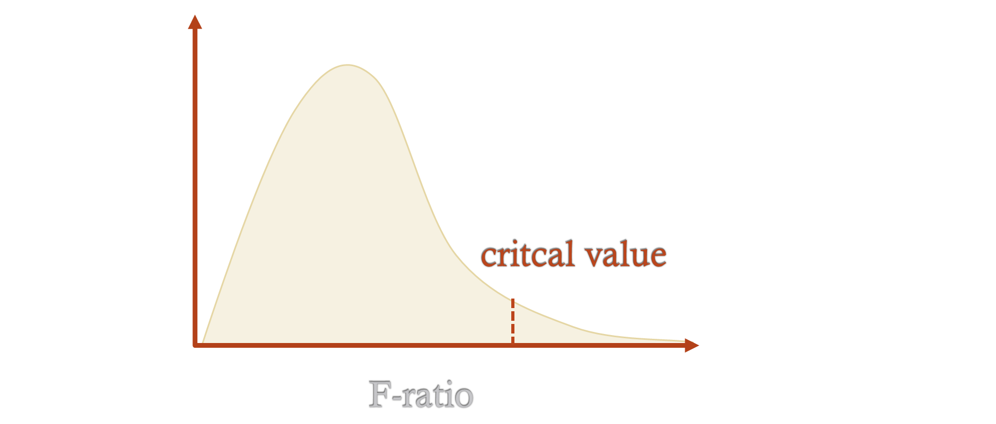
F-Distribution
F(3,8) = 2.9238 (for p < 0.1)

Slide 43

F-Distribution
F(3,8) = 2.9238 (for p < 0.1)
$$v_{1}/DF1$$

Slide 44

F-Distribution
$$v_{2}/DF2$$
F(3,8) = 2.9238 (for p < 0.1)
$$v_{1}/DF1$$

Slide 45

F-Distribution
$$v_{2}/DF2$$
F(3,8) = 2.9238 (for p < 0.1)
$$v_{1}/DF1$$
$$α (Level of significance)$$

Slide 46
F-Distribution
F(4,9) = ? (for p < 0.05)

Slide 47
F-Distribution
F(4,9) = 3.6331 (for p < 0.05)

Slide 48
ANOVA (One-way)
Step 4: Calculate the f-ratio
$Σ{(x}_{1i}$-${\overline{x}}_{1}$)² | $Σ{(x}_{2i}$-${\overline{x}}_{2}$)² | $Σ{(x}_{3i}$-${\overline{x}}_{1}$)²
2 | 2 | 8
$Σ$ = 12
Non-smoker | Weak smoker | Strong smoker
4 | 5 | 5
5 | 6 | 7
6 | 7 | 9
$n{(μ}_{1}$-$\overline{μ}$)² | $n$($μ_{1}$-$\overline{μ})²$ | $n{(μ}_{2}$-$\overline{μ}$)²
3$⋅$(5-6)² = 3 | 3$⋅$(6-6)² = 0 | 3$⋅$(7-6)² = 3
$Σ$ = 6
Calculate the ratio of f
SSC = Sum of
squares (columns)
Calculation | Sum of squares | Degrees of freedom | Mean sum of squares | f
Between Samples | 6 | $v_{1}$= 3 – 1 = 2 | MSC= 6/$2$ = 3 | $$\frac{3}{2}=1.5$$
Within Samples | 12 | $v_{2}$= 9 – 3 = 6 | MSE= 12/6 =2
SSE = Sum of
squares (rows)
MSC = Mean sum of
squares (betw. samples)
MSE = Mean sum of
squares (within sample)

Slide 49

ANOVA (One-way)
Step 4: Calculate the f-ratio
Calculation | Sum of squares | Degrees of freedom | Mean sum of squares | f
Between Samples | 6 | $v_{1}$= 3 – 1 = 2 | MSC= 6/$2$ = 3 | $$\frac{3}{2}=1.5$$
Within Samples | 12 | $v_{2}$= 9 – 3 = 6 | MSE= 12/6 =2
F(2,6) = ? (for p < 0.05)

Slide 50
ANOVA (One-way)
Step 4: Calculate the f-ratio
Calculation | Sum of squares | Degrees of freedom | Mean sum of squares | f
Between Samples | 6 | $v_{1}$= 3 – 1 = 2 | MSC= 6/$2$ = 3 | $$\frac{3}{2}=1.5$$
Within Samples | 12 | $v_{2}$= 9 – 3 = 6 | MSE= 12/6 =2
F(2,6) = 5.14 (for p < 0.05)

Slide 51
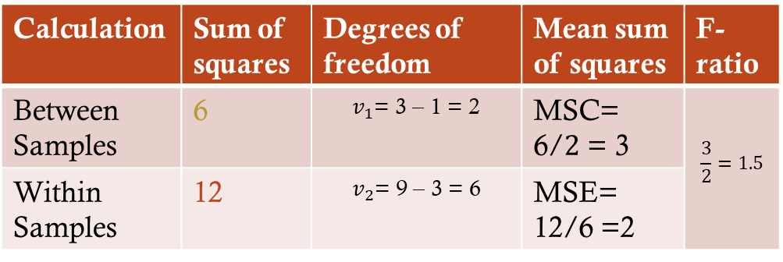
ANOVA (One-way)
Step 5: Compare the calculated f-ratio with table value
Calculation | Sum of squares | Degrees of freedom | Mean sum of squares | F-ratio
Between Samples | 6 | $v_{1}$= 3 – 1 = 2 | MSC= 6/$2$ = 3 | $$\frac{3}{2}=1.5$$
Within Samples | 12 | $v_{2}$= 9 – 3 = 6 | MSE= 12/6 =2
F(2,6) = 5.14 (for p < 0.05)
Calculated value = 1.5

Slide 52
ANOVA (One-way)
Step 5: Compare the calculated f-ratio with table value
Calculation | Sum of squares | Degrees of freedom | Mean sum of squares | F-ratio
Between Samples | 6 | $v_{1}$= 3 – 1 = 2 | MSC= 6/$2$ = 3 | $$\frac{3}{2}=1.5$$
Within Samples | 12 | $v_{2}$= 9 – 3 = 6 | MSE= 12/6 =2
F(2,6) = 5.14 (for p < 0.05)
Calculated value = 1.5

Slide 53
ANOVA (One-way)
Step 5: Compare the calculated f-ratio with table value
Calculation | Sum of squares | Degrees of freedom | Mean sum of squares | F-ratio
Between Samples | 6 | $v_{1}$= 3 – 1 = 2 | MSC= 6/$2$ = 3 | $$\frac{3}{2}=1.5$$
Within Samples | 12 | $v_{2}$= 9 – 3 = 6 | MSE= 12/6 =2
1.5
5.14
<
Critical value

Slide 54
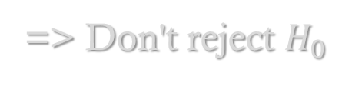
ANOVA (One-way)
Step 5: Compare the calculated f-ratio with table value
Calculation | Sum of squares | Degrees of freedom | Mean sum of squares | F-ratio
Between Samples | 6 | $v_{1}$= 3 – 1 = 2 | MSC= 6/$2$ = 3 | $$\frac{3}{2}=1.5$$
Within Samples | 12 | $v_{2}$= 9 – 3 = 6 | MSE= 12/6 =2
1.5
5.14
<
Critical value
=> Don't reject $H_{0}$

Slide 55
F-Distribution
F(2,6) = 5.14 (for p < 0.05)

Slide 56
F-Distribution
How a one-way ANOVA test works
How we calculate the f-ratio
How we interpret the results

Slide 57
ANOVA (Two-way)
 | Non-smoker | Weak smoker | Strong smoker
Younger | 4 | 5 | 5
Younger | 5 | 6 | 7
Older | 2 | 3 | 4
Older | 5 | 4 | 5

Slide 58
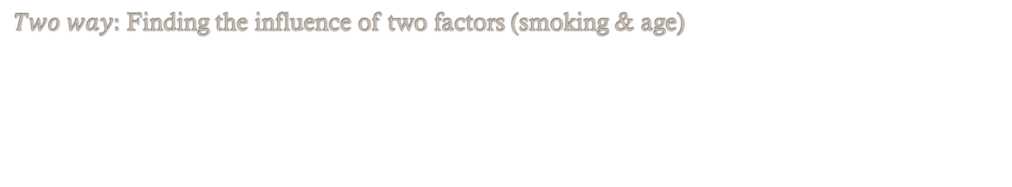
ANOVA (Two-way)
 | Non-smoker | Weak smoker | Strong smoker
Younger | 4 | 5 | 5
Younger | 5 | 6 | 7
Older | 2 | 3 | 4
Older | 5 | 4 | 5
$Two way:$ Finding the influence of two factors (smoking & age)

Slide 59
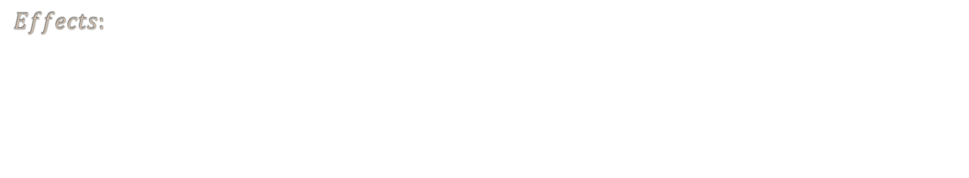
ANOVA (Two-way)
 | Non-smoker | Weak smoker | Strong smoker
Younger | 4 | 5 | 5
Younger | 5 | 6 | 7
Older | 2 | 3 | 4
Older | 5 | 4 | 5
$Two way:$ Finding the influence of two factors (smoking & age)
$$Effects:$$

Slide 60
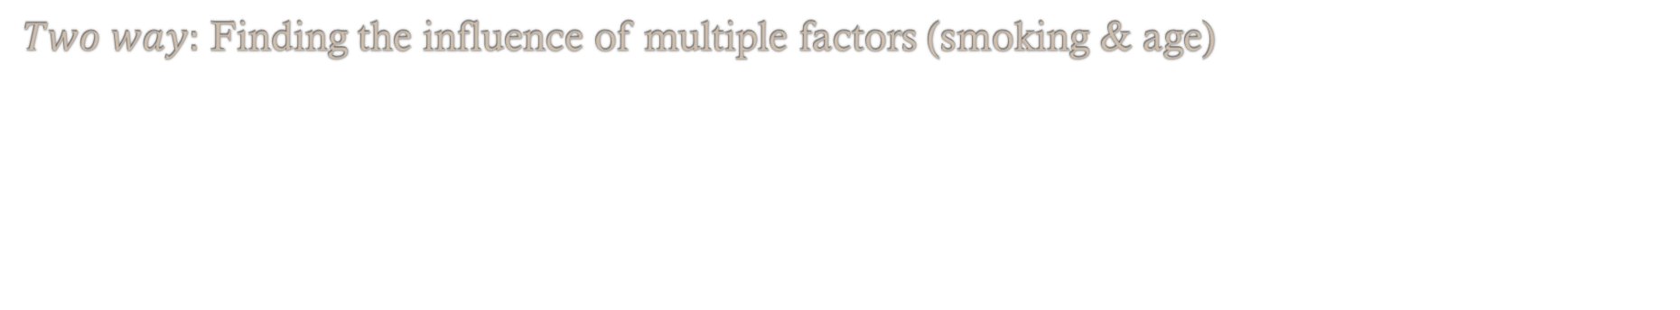
ANOVA (Two-way)
 | Non-smoker | Weak smoker | Strong smoker
Younger | 4 | 5 | 5
Younger | 5 | 6 | 7
Older | 2 | 3 | 4
Older | 5 | 4 | 5
$Two way:$ Finding the influence of multiple factors (smoking & age)
$$Effects:$$
Age groups have / don't have an effect on the aggressiveness

Slide 61
ANOVA (Two-way)
 | Non-smoker | Weak smoker | Strong smoker
Younger | 4 | 5 | 5
Younger | 5 | 6 | 7
Older | 2 | 3 | 4
Older | 5 | 4 | 5
$Two way:$ Finding the influence of multiple factors (smoking & age)
$$Effects:$$
Age groups have / don't have an effect on the aggressiveness

Slide 62
ANOVA (Two-way)
 | Non-smoker | Weak smoker | Strong smoker
Younger | 4 | 5 | 5
Younger | 5 | 6 | 7
Older | 2 | 3 | 4
Older | 5 | 4 | 5
$Two way:$ Finding the influence of multiple factors (smoking & age)
$$Effects:$$
Age groups have / don't have an effect on the aggressiveness
Smoking has / doesn't have an effect on the aggressiveness

Slide 63
ANOVA (Two-way)
 | Non-smoker | Weak smoker | Strong smoker
Younger | 4 | 5 | 5
Younger | 5 | 6 | 7
Older | 2 | 3 | 4
Older | 5 | 4 | 5
$Two way:$ Finding the influence of multiple factors (smoking & age)
$$Effects:$$
Age groups have / don't have an effect on the aggressiveness
Smoking has / doen't have an effect on the aggressiveness
Age group influences whether the smoking has an effect on the aggressiveness or not
(interaction)

Slide 64
ANOVA (Two-way)
Step 1: State the null hypothesis
 | Non-smoker | Weak smoker | Strong smoker
Younger | 4 | 5 | 5
Younger | 5 | 6 | 7
Older | 2 | 3 | 4
Older | 5 | 4 | 5

Slide 65
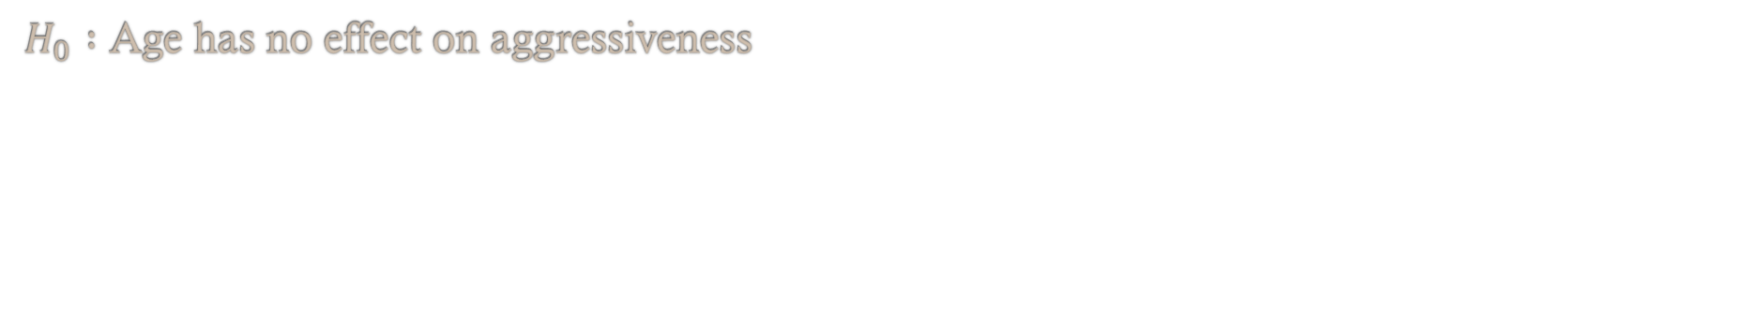
ANOVA (Two-way)
Step 1: State the null hypothesis
 | Non-smoker | Weak smoker | Strong smoker
Younger | 4 | 5 | 5
Younger | 5 | 6 | 7
Older | 2 | 3 | 4
Older | 5 | 4 | 5
$H_{0} :$ Age has no effect on aggressiveness

Slide 66
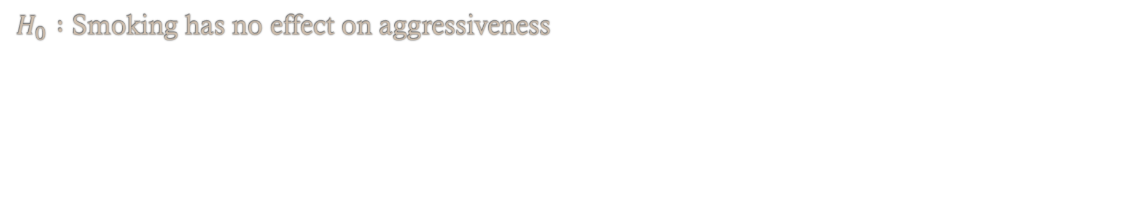
ANOVA (Two-way)
Step 1: State the null hypothesis
 | Non-smoker | Weak smoker | Strong smoker
Younger | 4 | 5 | 5
Younger | 5 | 6 | 7
Older | 2 | 3 | 4
Older | 5 | 4 | 5
$H_{0} :$ Age has no effect on aggressiveness
$H_{0} :$ Smoking has no effect on aggressiveness

Slide 67
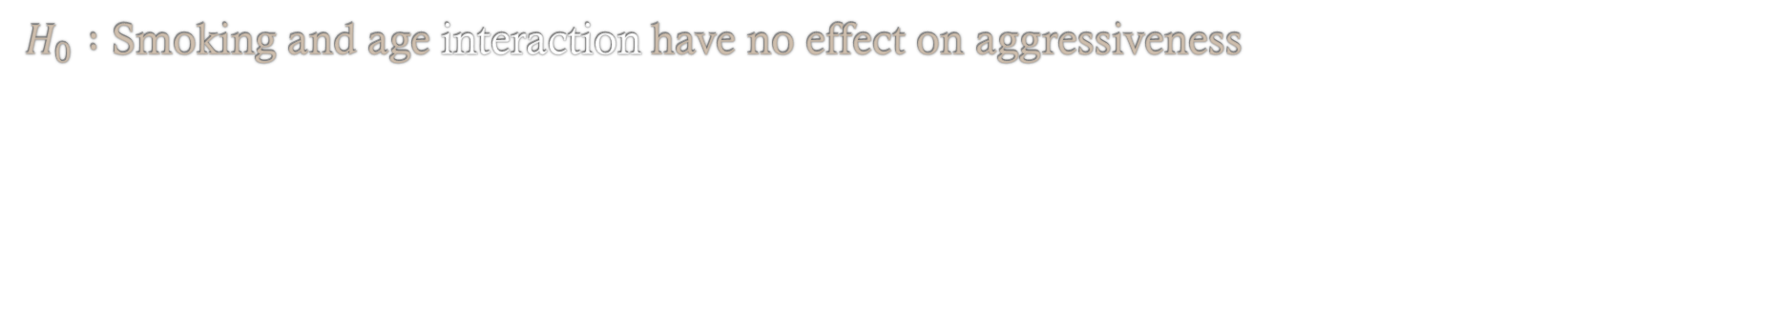
ANOVA (Two-way)
Step 1: State the null hypothesis
 | Non-smoker | Weak smoker | Strong smoker
Younger | 4 | 5 | 5
Younger | 5 | 6 | 7
Older | 2 | 3 | 4
Older | 5 | 4 | 5
$H_{0} :$ Age has no effect on aggressiveness
$H_{0} :$ Smoking has no effect on aggressiveness
$H_{0} :$ Smoking and age interaction have no effect on aggressiveness

Slide 68
ANOVA (Two-way)
Step 2: Calculate the Colum and Row totals
Sum of squares 1st factor (Smoking)
+
Sum of squares 2nd factor (Age)
+
Sum of squares (within)
+
Sum of squares (Error)
Sum of Squares (Total)

Slide 69
ANOVA (Two-way)
Step 2: Calculate the Colum and Row totals
Sum of squares 1st factor (Smoking)
+
Sum of squares 2nd factor (Age)
+
Sum of squares (within)
+
Sum of squares (Error)
Sum of Squares (Total)

Slide 70
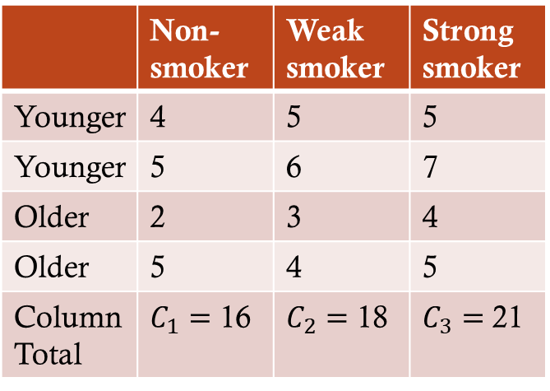
ANOVA (Two-way)
Step 2: Calculate the Column and Row totals
 | Non-smoker | Weak smoker | Strong smoker
Younger | 4 | 5 | 5
Younger | 5 | 6 | 7
Older | 2 | 3 | 4
Older | 5 | 4 | 5
Column Total | $C_{1}=$ 16 | $C_{2}=$ 18 | $C_{3}=$21

Slide 71
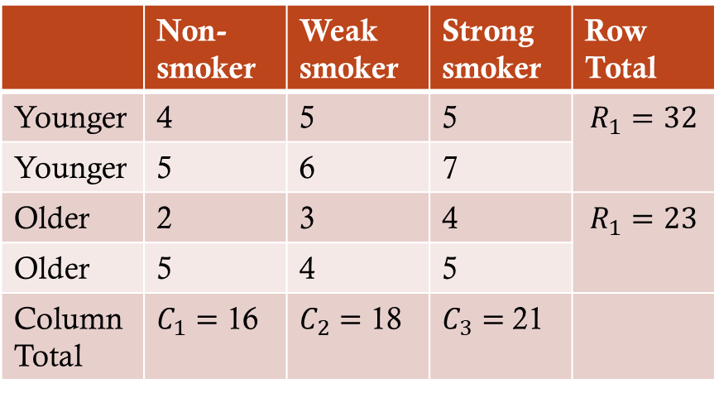
ANOVA (Two-way)
Step 2: Calculate the Column and Row totals
 | Non-smoker | Weak smoker | Strong smoker | Row Total
Younger | 4 | 5 | 5 | $$R_{1}=32$$
Younger | 5 | 6 | 7
Older | 2 | 3 | 4 | $$R_{1}=23$$
Older | 5 | 4 | 5
Column Total | $C_{1}=$ 16 | $C_{2}=$ 18 | $C_{3}=$21

Slide 72

ANOVA (Two-way)
Step 3: Calculate the Sums of Squares
 | Non-smoker | Weak smoker | Strong smoker | Row Total
Younger | 4 | 5 | 5 | $$R_{1}=32$$
Younger | 5 | 6 | 7
Older | 2 | 3 | 4 | $$R_{1}=23$$
Older | 5 | 4 | 5
Column Total | $C_{1}=$ 16 | $C_{2}=$ 18 | $C_{3}=$21
Correction term $\left(C_{x}\right)$= $\frac{{\left(Σx_{i}\right)}^{2}}{number of observations}$

Slide 73

ANOVA (Two-way)
Step 3: Calculate the Sums of Squares
 | Non-smoker | Weak smoker | Strong smoker | Row Total
Younger | 4 | 5 | 5 | $$R_{1}=32$$
Younger | 5 | 6 | 7
Older | 2 | 3 | 4 | $$R_{1}=23$$
Older | 5 | 4 | 5
Column Total | $C_{1}=$ 16 | $C_{2}=$ 18 | $C_{3}=$21
Correction term $\left(C_{x}\right)$= $\frac{{\left(32+23\right)}^{2}}{number of observations}$

Slide 74

ANOVA (Two-way)
Step 3: Calculate the Sums of Squares
 | Non-smoker | Weak smoker | Strong smoker | Row Total
Younger | 4 | 5 | 5 | $$R_{1}=32$$
Younger | 5 | 6 | 7
Older | 2 | 3 | 4 | $$R_{1}=23$$
Older | 5 | 4 | 5
Column Total | $C_{1}=$ 16 | $C_{2}=$ 18 | $C_{3}=$21
Correction term $\left(C_{x}\right)$= $\frac{{\left(16+18+21\right)}^{2}}{number of observations}$

Slide 75

ANOVA (Two-way)
Step 3: Calculate the Sums of Squares
 | Non-smoker | Weak smoker | Strong smoker | Row Total
Younger | 4 | 5 | 5 | $$R_{1}=32$$
Younger | 5 | 6 | 7
Older | 2 | 3 | 4 | $$R_{1}=23$$
Older | 5 | 4 | 5
Column Total | $C_{1}=$ 16 | $C_{2}=$ 18 | $C_{3}=$21
Correction term $\left(C_{x}\right)$= $\frac{{\left(16+18+21\right)}^{2}}{12}$

Slide 76

ANOVA (Two-way)
Step 3: Calculate the Sums of Squares
 | Non-smoker | Weak smoker | Strong smoker | Row Total
Younger | 4 | 5 | 5 | $$R_{1}=32$$
Younger | 5 | 6 | 7
Older | 2 | 3 | 4 | $$R_{1}=23$$
Older | 5 | 4 | 5
Column Total | $C_{1}=$ 16 | $C_{2}=$ 18 | $C_{3}=$21
Correction term $\left(C_{x}\right)$= $\frac{{\left(16+18+21\right)}^{2}}{12}$ = $\frac{3025}{12}=252.08$

Slide 77

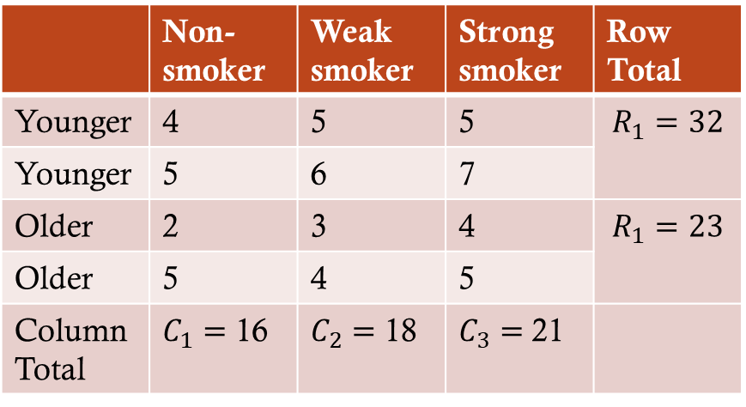

ANOVA (Two-way)
Step 3: Calculate the Sums of Squares
 | Non-smoker | Weak smoker | Strong smoker | Row Total
Younger | 4 | 5 | 5 | $$R_{1}=32$$
Younger | 5 | 6 | 7
Older | 2 | 3 | 4 | $$R_{1}=23$$
Older | 5 | 4 | 5
Column Total | $C_{1}=$ 16 | $C_{2}=$ 18 | $C_{3}=$21
Correction term $\left(C_{x}\right)$= $\frac{{\left(16+18+21\right)}^{2}}{12}$ = $\frac{3025}{12}=252.08$
Sum of squares Total $\left(SS_{T}\right)$= $\sum{x_{i}^{2}}−$ $C_{x}$

Slide 78


ANOVA (Two-way)
Step 3: Calculate the Sums of Squares
 | Non-smoker | Weak smoker | Strong smoker | Row Total
Younger | 4 | 5 | 5 | $$R_{1}=32$$
Younger | 5 | 6 | 7
Older | 2 | 3 | 4 | $$R_{1}=23$$
Older | 5 | 4 | 5
Column Total | $C_{1}=$ 16 | $C_{2}=$ 18 | $C_{3}=$21
Correction term $\left(C_{x}\right)$= $\frac{{\left(16+18+21\right)}^{2}}{12}$ = $\frac{3025}{12}=252.08$
Sum of squares Total $\left(SS_{T}\right)$= $\sum{x_{i}^{2}}−$ $C_{x}$
Sum of squares Total $\left(SS_{T}\right)$= $4^{2}+5^{2}+…+5^{2}−$ $252.08$
Sum of squares Total $\left(SS_{T}\right)$= $271−$ $252.08$
Sum of squares Total $\left(SS_{T}\right)$= $18.92$

Slide 79

ANOVA (Two-way)
Step 3: Calculate the Sums of Squares
 | Non-smoker | Weak smoker | Strong smoker | Row Total
Younger | 4 | 5 | 5 | $$R_{1}=32$$
Younger | 5 | 6 | 7
Older | 2 | 3 | 4 | $$R_{1}=23$$
Older | 5 | 4 | 5
Column Total | $C_{1}=$ 16 | $C_{2}=$ 18 | $C_{3}=$21
Correction term $\left(C_{x}\right)$= $\frac{{\left(16+18+21\right)}^{2}}{12}$ = $\frac{3025}{12}=252.08$
Sum of squares Total $\left(SS_{T}\right)$= $18.92$

Slide 80

ANOVA (Two-way)
Step 3: Calculate the Sums of Squares
 | Non-smoker | Weak smoker | Strong smoker | Row Total
Younger | 4 | 5 | 5 | $$R_{1}=32$$
Younger | 5 | 6 | 7
Older | 2 | 3 | 4 | $$R_{1}=23$$
Older | 5 | 4 | 5
Column Total | $C_{1}=$ 16 | $C_{2}=$ 18 | $C_{3}=$21
Correction term $\left(C_{x}\right)$= $\frac{{\left(16+18+21\right)}^{2}}{12}$ = $\frac{3025}{12}=252.08$
Sum of squares Total $\left(SS_{T}\right)$= $18.92$
Sum of squares Columns $\left(SS_{C}\right)$= $\frac{\sum{C_{i}^{2}}}{a}− C_{x}$

Slide 81
ANOVA (Two-way)
Step 3: Calculate the Sums of Squares
 | Non-smoker | Weak smoker | Strong smoker | Row Total
Younger | 4 | 5 | 5 | $$R_{1}=32$$
Younger | 5 | 6 | 7
Older | 2 | 3 | 4 | $$R_{1}=23$$
Older | 5 | 4 | 5
Column Total | $C_{1}=$ 16 | $C_{2}=$ 18 | $C_{3}=$21
Correction term $\left(C_{x}\right)$= $\frac{{\left(16+18+21\right)}^{2}}{12}$ = $\frac{3025}{12}=252.08$
Sum of squares Total $\left(SS_{T}\right)$= $18.92$
Sum of squares Columns $\left(SS_{C}\right)$= $\frac{\sum{C_{i}^{2}}}{a}− C_{x}$
Sum of squares Columns $\left(SS_{C}\right)$= $\frac{\text{(16²+18²+21²)}}{4}−252.08$
Sum of squares Columns $\left(SS_{C}\right)$= $\frac{\text{1021}}{4}−252.08=3.17$

Slide 82

ANOVA (Two-way)
Step 3: Calculate the Sums of Squares
 | Non-smoker | Weak smoker | Strong smoker | Row Total
Younger | 4 | 5 | 5 | $$R_{1}=32$$
Younger | 5 | 6 | 7
Older | 2 | 3 | 4 | $$R_{1}=23$$
Older | 5 | 4 | 5
Column Total | $C_{1}=$ 16 | $C_{2}=$ 18 | $C_{3}=$21
Correction term $\left(C_{x}\right)$= $\frac{{\left(16+18+21\right)}^{2}}{12}$ = $\frac{3025}{12}=252.08$
Sum of squares Total $\left(SS_{T}\right)$= $18.92$
Sum of squares Columns $\left(SS_{C}\right)=3.17$

Slide 83

ANOVA (Two-way)
Step 3: Calculate the Sums of Squares
 | Non-smoker | Weak smoker | Strong smoker | Row Total
Younger | 4 | 5 | 5 | $$R_{1}=32$$
Younger | 5 | 6 | 7
Older | 2 | 3 | 4 | $$R_{1}=23$$
Older | 5 | 4 | 5
Column Total | $C_{1}=$ 16 | $C_{2}=$ 18 | $C_{3}=$21
Correction term $\left(C_{x}\right)$= $\frac{{\left(16+18+21\right)}^{2}}{12}$ = $\frac{3025}{12}=252.08$
Sum of squares Total $\left(SS_{T}\right)$= $18.92$
Sum of squares Columns $\left(SS_{C}\right)=3.17$
Sum of squares Rows $\left(SS_{R}\right)$= $\frac{\sum{R_{i}^{2}}}{b}− C_{x}$

Slide 84




ANOVA (Two-way)
Step 3: Calculate the Sums of Squares
 | Non-smoker | Weak smoker | Strong smoker | Row Total
Younger | 4 | 5 | 5 | $$R_{1}=32$$
Younger | 5 | 6 | 7
Older | 2 | 3 | 4 | $$R_{1}=23$$
Older | 5 | 4 | 5
Column Total | $C_{1}=$ 16 | $C_{2}=$ 18 | $C_{3}=$21
Correction term $\left(C_{x}\right)$= $\frac{{\left(16+18+21\right)}^{2}}{12}$ = $\frac{3025}{12}=252.08$
Sum of squares Total $\left(SS_{T}\right)$= $18.92$
Sum of squares Columns $\left(SS_{C}\right)=3.17$
Sum of squares Rows $\left(SS_{R}\right)$= $\frac{\sum{R_{i}^{2}}}{b}− C_{x}$
Sum of squares Rows $\left(SS_{R}\right)$= $\frac{\text{(}\text{32}\text{²+}\text{23}\text{²)}}{6}−252.08$
Sum of squares Rows $\left(SS_{R}\right)$= $\frac{\text{1553}}{6}−252.08=6.75$

Slide 85

ANOVA (Two-way)
Step 3: Calculate the Sums of Squares
 | Non-smoker | Weak smoker | Strong smoker | Row Total
Younger | 4 | 5 | 5 | $$R_{1}=32$$
Younger | 5 | 6 | 7
Older | 2 | 3 | 4 | $$R_{1}=23$$
Older | 5 | 4 | 5
Column Total | $C_{1}=$ 16 | $C_{2}=$ 18 | $C_{3}=$21
Correction term $\left(C_{x}\right)$= $\frac{{\left(16+18+21\right)}^{2}}{12}$ = $\frac{3025}{12}=252.08$
Sum of squares Total $\left(SS_{T}\right)$= $18.92$
Sum of squares Columns $\left(SS_{C}\right)=3.17$
Sum of squares Rows $\left(SS_{R}\right)=6.75$

Slide 86
ANOVA (Two-way)
Step 3: Calculate the Sums of Squares
 | Non-smoker | Weak smoker | Strong smoker | Row Total
Younger | 4 | 5 | 5 | $$R_{1}=32$$
Younger | 5 | 6 | 7
Older | 2 | 3 | 4 | $$R_{1}=23$$
Older | 5 | 4 | 5
Column Total | $C_{1}=$ 16 | $C_{2}=$ 18 | $C_{3}=$21
Correction term $\left(C_{x}\right)$= $\frac{{\left(16+18+21\right)}^{2}}{12}$ = $\frac{3025}{12}=252.08$
Sum of squares Total $\left(SS_{T}\right)$= $18.92$
Sum of squares Columns $\left(SS_{C}\right)=3.17$
Sum of squares Rows $\left(SS_{R}\right)=6.75$

Slide 87

ANOVA (Two-way)
Step 3: Calculate the Sums of Squares
 | Non-smoker | Weak smoker | Strong smoker | Row Total
Younger | 4 | 5 | 5 | $$R_{1}=32$$
Younger | 5 | 6 | 7
Older | 2 | 3 | 4 | $$R_{1}=23$$
Older | 5 | 4 | 5
Column Total | $C_{1}=$ 16 | $C_{2}=$ 18 | $C_{3}=$21
Correction term $\left(C_{x}\right)$= $\frac{{\left(16+18+21\right)}^{2}}{12}$ = $\frac{3025}{12}=252.08$
Sum of squares Total $\left(SS_{T}\right)$= $18.92$
Sum of squares Columns $\left(SS_{C}\right)=3.17$
Sum of squares Rows $\left(SS_{R}\right)=6.75$
Sum of squares within groups $\left(SS_{G}\right)$= $\frac{\sum{G_{i}^{2}}}{r}−SS_{C}−SS_{R}−$ $C_{x}$

Slide 88
ANOVA (Two-way)
Step 3: Calculate the Sums of Squares
 | Non-smoker | Weak smoker | Strong smoker | Row Total
Younger | 4 | 5 | 5 | $$R_{1}=32$$
Younger | 5 | 6 | 7
Older | 2 | 3 | 4 | $$R_{1}=23$$
Older | 5 | 4 | 5
Column Total | $C_{1}=$ 16 | $C_{2}=$ 18 | $C_{3}=$21
Correction term $\left(C_{x}\right)$= $\frac{{\left(16+18+21\right)}^{2}}{12}$ = $\frac{3025}{12}=252.08$
9
11
12
Sum of squares Total $\left(SS_{T}\right)$= $18.92$
Sum of squares Columns $\left(SS_{C}\right)=3.17$
7
7
9
Sum of squares Rows $\left(SS_{R}\right)=6.75$
Sum of squares within groups $\left(SS_{G}\right)$= $\frac{\sum{G_{i}^{2}}}{r}−SS_{C}−SS_{R}−$ $C_{x}$

Slide 89

ANOVA (Two-way)
Step 3: Calculate the Sums of Squares
 | Non-smoker | Weak smoker | Strong smoker | Row Total
Younger | 4 | 5 | 5 | $$R_{1}=32$$
Younger | 5 | 6 | 7
Older | 2 | 3 | 4 | $$R_{1}=23$$
Older | 5 | 4 | 5
Column Total | $C_{1}=$ 16 | $C_{2}=$ 18 | $C_{3}=$21
Correction term $\left(C_{x}\right)$= $\frac{{\left(16+18+21\right)}^{2}}{12}$ = $\frac{3025}{12}=252.08$
9
11
12
Sum of squares Total $\left(SS_{T}\right)$= $18.92$
Sum of squares Columns $\left(SS_{C}\right)=3.17$
7
7
9
Sum of squares Rows $\left(SS_{R}\right)=6.75$
Sum of squares within groups $\left(SS_{G}\right)$= $\frac{\sum{G_{i}^{2}}}{r}−SS_{C}−SS_{R}−$ $C_{x}$
Sum of squares within groups $\left(SS_{G}\right)$= $\frac{\sum{9^{2}+{11}^{2}+…+9²}}{2}−SS_{C}−SS_{R}−C_{x}$

Slide 90

ANOVA (Two-way)
Step 3: Calculate the Sums of Squares
 | Non-smoker | Weak smoker | Strong smoker | Row Total
Younger | 4 | 5 | 5 | $$R_{1}=32$$
Younger | 5 | 6 | 7
Older | 2 | 3 | 4 | $$R_{1}=23$$
Older | 5 | 4 | 5
Column Total | $C_{1}=$ 16 | $C_{2}=$ 18 | $C_{3}=$21
Correction term $\left(C_{x}\right)$= $\frac{{\left(16+18+21\right)}^{2}}{12}$ = $\frac{3025}{12}=252.08$
9
11
12
Sum of squares Total $\left(SS_{T}\right)$= $18.92$
Sum of squares Columns $\left(SS_{C}\right)=3.17$
7
7
9
Sum of squares Rows $\left(SS_{R}\right)=6.75$
Sum of squares within groups $\left(SS_{G}\right)$= $\frac{\sum{G_{i}^{2}}}{r}−SS_{C}−SS_{R}−C_{x}$
Sum of squares within groups $\left(SS_{G}\right)$= $\frac{525}{2}−3.17−6.75 −252.08 =0.5$

Slide 91

ANOVA (Two-way)
Step 3: Calculate the Sums of Squares
 | Non-smoker | Weak smoker | Strong smoker | Row Total
Younger | 4 | 5 | 5 | $$R_{1}=32$$
Younger | 5 | 6 | 7
Older | 2 | 3 | 4 | $$R_{1}=23$$
Older | 5 | 4 | 5
Column Total | $C_{1}=$ 16 | $C_{2}=$ 18 | $C_{3}=$21
Correction term $\left(C_{x}\right)$= $\frac{{\left(16+18+21\right)}^{2}}{12}$ = $\frac{3025}{12}=252.08$
Sum of squares Total $\left(SS_{T}\right)$= $18.92$
Sum of squares Columns $\left(SS_{C}\right)=3.17$
Sum of squares Rows $\left(SS_{R}\right)=6.75$
Sum of squares within groups $\left(SS_{G}\right)$= $0.5$

Slide 92
ANOVA (Two-way)
Step 3: Calculate the Sums of Squares
 | Non-smoker | Weak smoker | Strong smoker | Row Total
Younger | 4 | 5 | 5 | $$R_{1}=32$$
Younger | 5 | 6 | 7
Older | 2 | 3 | 4 | $$R_{1}=23$$
Older | 5 | 4 | 5
Column Total | $C_{1}=$ 16 | $C_{2}=$ 18 | $C_{3}=$21
Correction term $\left(C_{x}\right)$= $\frac{{\left(16+18+21\right)}^{2}}{12}$ = $\frac{3025}{12}=252.08$
Sum of squares Total $\left(SS_{T}\right)$= $18.92$
Sum of squares Columns $\left(SS_{C}\right)=3.17$
Sum of squares Rows $\left(SS_{R}\right)=6.75$
Sum of squares within groups $\left(SS_{G}\right)$= $0.5$
Sum of Squares Error = ?

Slide 93
ANOVA (Two-way)
Step 2: Calculate the Colum and Row totals
Sum of squares 1st factor (Smoking)
+
Sum of squares 2nd factor (Age)
+
Sum of squares (within)
+
Sum of squares (Error)
Sum of Squares (Total)

Slide 94
ANOVA (Two-way)
Step 2: Calculate the Colum and Row totals
Sum of Squares (Total)
-
-
-
Sum of squares 1st factor (Smoking)
Sum of squares (within)
Sum of squares 2nd factor (Age)
=
Sum of squares (Error)

Slide 95
ANOVA (Two-way)
Step 3: Calculate the Sums of Squares
 | Non-smoker | Weak smoker | Strong smoker | Row Total
Younger | 4 | 5 | 5 | $$R_{1}=32$$
Younger | 5 | 6 | 7
Older | 2 | 3 | 4 | $$R_{1}=23$$
Older | 5 | 4 | 5
Column Total | $C_{1}=$ 16 | $C_{2}=$ 18 | $C_{3}=$21
Correction term $\left(C_{x}\right)$= $\frac{{\left(16+18+21\right)}^{2}}{12}$ = $\frac{3025}{12}=252.08$
Sum of squares Total $\left(SS_{T}\right)$= $18.92$
Sum of squares Columns $\left(SS_{C}\right)=3.17$
Sum of squares Rows $\left(SS_{R}\right)=6.75$
Sum of squares within groups $\left(SS_{G}\right)$= $0.5$
Sum of Squares Error $\left(SS_{G}\right)$=$SS_{T}−SS_{C}−SS_{R}−SS_{G}$

Slide 96
ANOVA (Two-way)
Step 3: Calculate the Sums of Squares
 | Non-smoker | Weak smoker | Strong smoker | Row Total
Younger | 4 | 5 | 5 | $$R_{1}=32$$
Younger | 5 | 6 | 7
Older | 2 | 3 | 4 | $$R_{1}=23$$
Older | 5 | 4 | 5
Column Total | $C_{1}=$ 16 | $C_{2}=$ 18 | $C_{3}=$21
Correction term $\left(C_{x}\right)$= $\frac{{\left(16+18+21\right)}^{2}}{12}$ = $\frac{3025}{12}=252.08$
Sum of squares Total $\left(SS_{T}\right)$= $18.92$
Sum of squares Columns $\left(SS_{C}\right)=3.17$
Sum of squares Rows $\left(SS_{R}\right)=6.75$
Sum of squares within groups $\left(SS_{G}\right)$= $0.5$
Sum of Squares Error $\left(SS_{E}\right)$=$SS_{T}−SS_{C}−SS_{R}−SS_{G}$
Sum of Squares Error $\left(SS_{E}\right)$=$18.92−3.17−6.75−0.5$ = 8.5

Slide 97


ANOVA (Two-way)
Step 3: Calculate the Sums of Squares
 | Non-smoker | Weak smoker | Strong smoker | Row Total
Younger | 4 | 5 | 5 | $$R_{1}=32$$
Younger | 5 | 6 | 7
Older | 2 | 3 | 4 | $$R_{1}=23$$
Older | 5 | 4 | 5
Column Total | $C_{1}=$ 16 | $C_{2}=$ 18 | $C_{3}=$21
Correction term $\left(C_{x}\right)$= $\frac{{\left(16+18+21\right)}^{2}}{12}$ = $\frac{3025}{12}=252.08$
Sum of squares Total $\left(SS_{T}\right)$= $18.92$
Sum of squares Columns $\left(SS_{C}\right)=3.17$
Sum of squares Rows $\left(SS_{R}\right)=6.75$
Sum of squares within groups $\left(SS_{G}\right)$ = $0.5$
Sum of Squares Error $\left(SS_{E}\right)$= 8.5

Slide 98
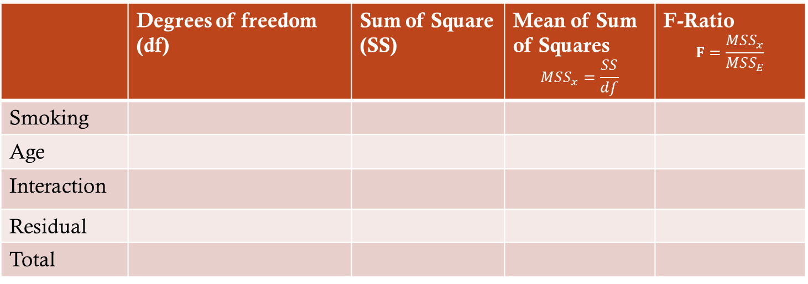
ANOVA (Two-way)
Step 4: Calculate the F-ratio
 | Degrees of freedom (df) | Sum of Square (SS) | Mean of Sum of Squares $$MSS_{x}=\frac{SS}{df}$$ | F-Ratio $$F=\frac{MSS_{x}}{MSS_{E}}$$
Smoking
Age
Interaction
Residual
Total

Slide 99
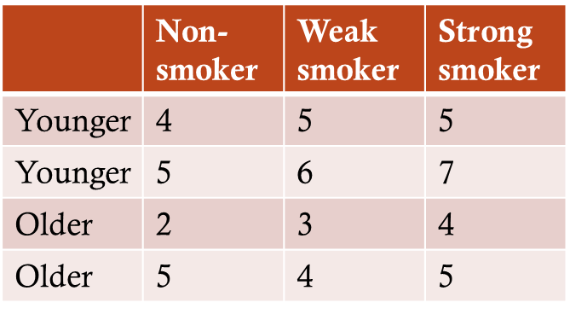

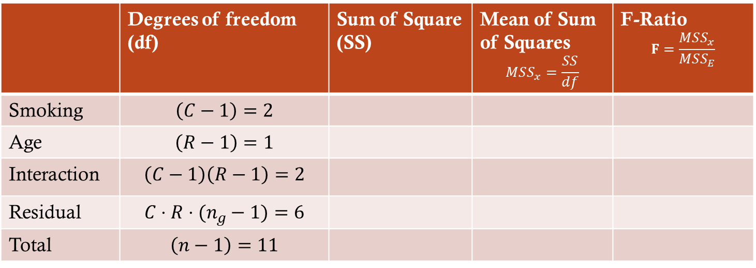
ANOVA (Two-way)
Step 4: Calculate the F-ratio
 | Degrees of freedom (df) | Sum of Square (SS) | Mean of Sum of Squares $$MSS_{x}=\frac{SS}{df}$$ | F-Ratio $$F=\frac{MSS_{x}}{MSS_{E}}$$
Smoking | $$\left(C−1\right)=2$$
Age | $$\left(R−1\right)=1$$
Interaction | $$\left(C−1\right)\left(R−1\right)=2$$
Residual | $$C⋅R⋅(n_{g}−1)=6$$
Total | $$\left(n−1\right)=11$$
$$C : no. of columns (smoking categories)$$
$$R : no. of rows \left(age categories\right)$$
$$n_{g}: no. of ′people′ in one group$$
$$n :total no .of ′people′$$

Slide 100

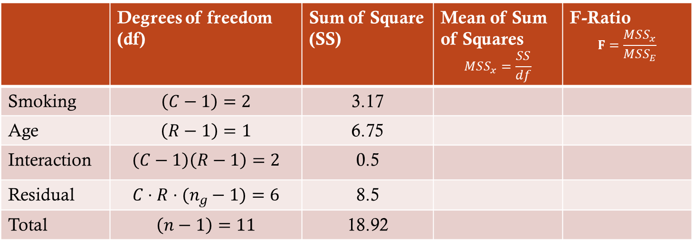
ANOVA (Two-way)
Step 4: Calculate the F-ratio
 | Degrees of freedom (df) | Sum of Square (SS) | Mean of Sum of Squares $$MSS_{x}=\frac{SS}{df}$$ | F-Ratio $$F=\frac{MSS_{x}}{MSS_{E}}$$
Smoking | $$\left(C−1\right)=2$$ | 3.17
Age | $$\left(R−1\right)=1$$ | 6.75
Interaction | $$\left(C−1\right)\left(R−1\right)=2$$ | 0.5
Residual | $$C⋅R⋅(n_{g}−1)=6$$ | 8.5
Total | $$\left(n−1\right)=11$$ | 18.92
$$C : no. of columns (smoking categories)$$
$$R : no. of rows \left(age categories\right)$$
$$n_{g}: no. of ′people′ in one group$$
$$n :total no .of ′people′$$

Slide 101
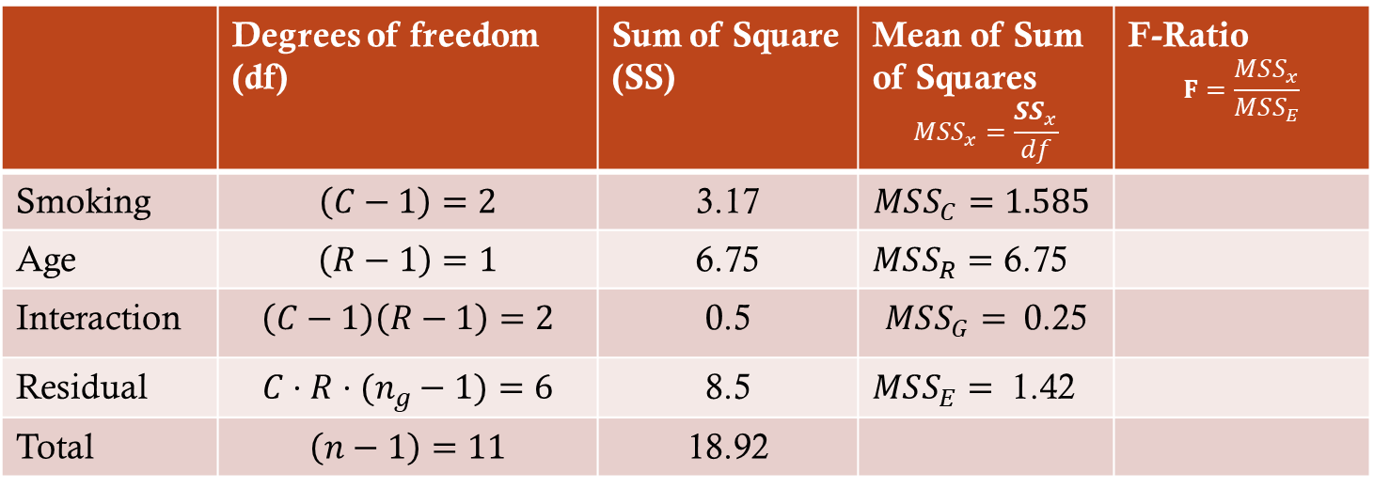
ANOVA (Two-way)
Step 4: Calculate the F-ratio
 | Degrees of freedom (df) | Sum of Square (SS) | Mean of Sum of Squares $$MSS_{x}=\frac{{SS}_{x}}{df}$$ | F-Ratio $$F=\frac{MSS_{x}}{MSS_{E}}$$
Smoking | $$\left(C−1\right)=2$$ | 3.17 | $MSS_{C}=1.585$
Age | $$\left(R−1\right)=1$$ | 6.75 | $MSS_{R}=$ 6.75
Interaction | $$\left(C−1\right)\left(R−1\right)=2$$ | 0.5 | $MSS_{G}=$ 0.25
Residual | $$C⋅R⋅(n_{g}−1)=6$$ | 8.5 | $MSS_{E}=$ 1.42
Total | $$\left(n−1\right)=11$$ | 18.92
$$C : no. of columns (smoking categories)$$
$$R : no. of rows \left(age categories\right)$$
$$n_{g}: no. of ′people′ in one group$$
$$n :total no .of ′people′$$

Slide 102
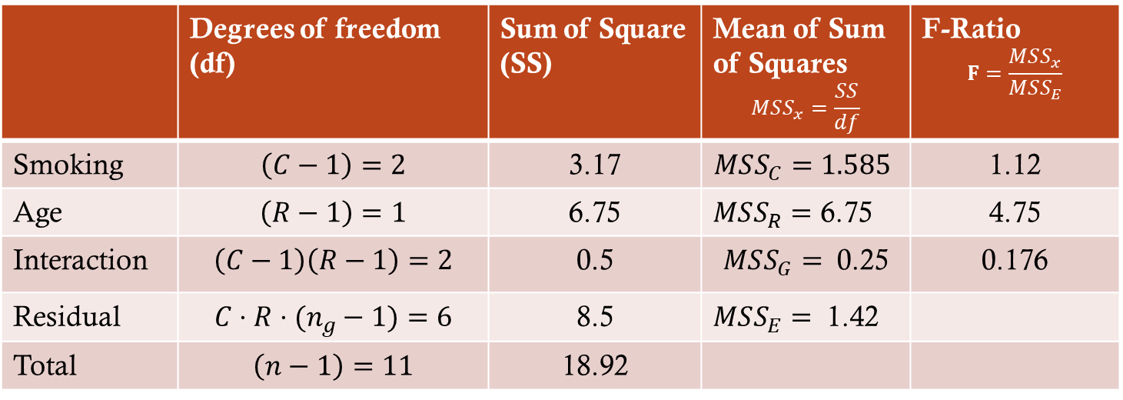
ANOVA (Two-way)
Step 4: Calculate the F-ratio
 | Degrees of freedom (df) | Sum of Square (SS) | Mean of Sum of Squares $$MSS_{x}=\frac{SS}{df}$$ | F-Ratio $$F=\frac{MSS_{x}}{MSS_{E}}$$
Smoking | $$\left(C−1\right)=2$$ | 3.17 | $MSS_{C}=1.585$ | 1.12
Age | $$\left(R−1\right)=1$$ | 6.75 | $MSS_{R}=$ 6.75 | 4.75
Interaction | $$\left(C−1\right)\left(R−1\right)=2$$ | 0.5 | $MSS_{G}=$ 0.25 | 0.176
Residual | $$C⋅R⋅(n_{g}−1)=6$$ | 8.5 | $MSS_{E}=$ 1.42
Total | $$\left(n−1\right)=11$$ | 18.92
$$C : no. of columns (smoking categories)$$
$$R : no. of rows \left(age categories\right)$$
$$n_{g}: no. of ′people′ in one group$$
$$n :total no .of ′people′$$

Slide 103
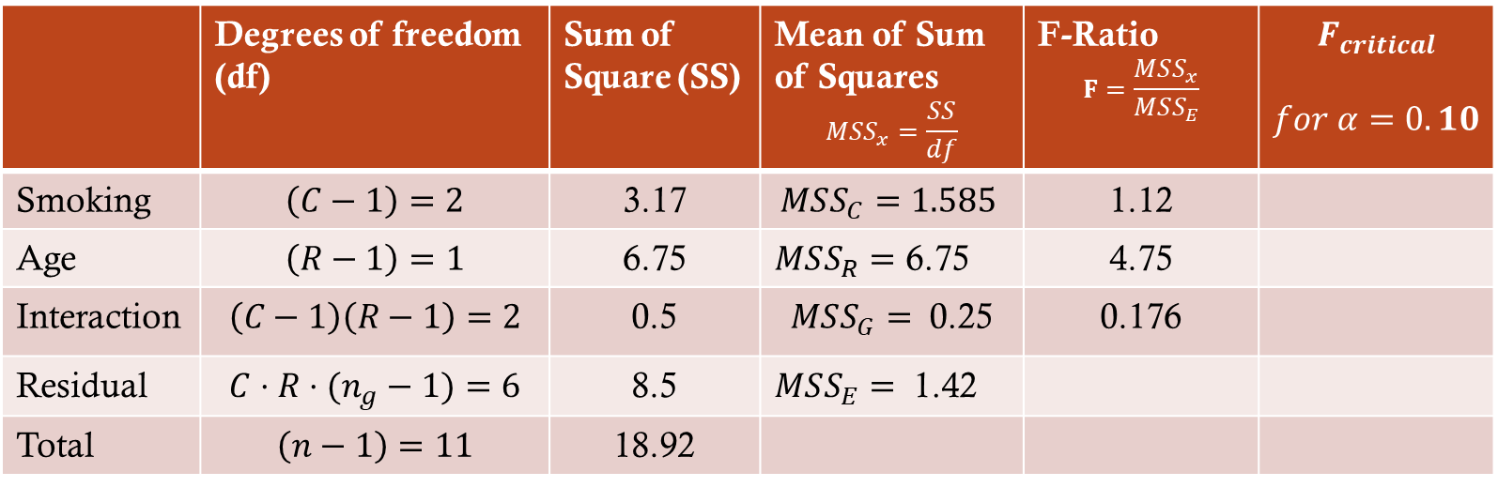
ANOVA (Two-way)
Step 5: Compare with critical value
 | Degrees of freedom (df) | Sum of Square (SS) | Mean of Sum of Squares $$MSS_{x}=\frac{SS}{df}$$ | F-Ratio $$F=\frac{MSS_{x}}{MSS_{E}}$$ | $$F_{critical}$$ $$for α=0.10$$
Smoking | $$\left(C−1\right)=2$$ | 3.17 | $MSS_{C}=1.585$ | 1.12
Age | $$\left(R−1\right)=1$$ | 6.75 | $MSS_{R}=$ 6.75 | 4.75
Interaction | $$\left(C−1\right)\left(R−1\right)=2$$ | 0.5 | $MSS_{G}=$ 0.25 | 0.176
Residual | $$C⋅R⋅(n_{g}−1)=6$$ | 8.5 | $MSS_{E}=$ 1.42
Total | $$\left(n−1\right)=11$$ | 18.92

Slide 104
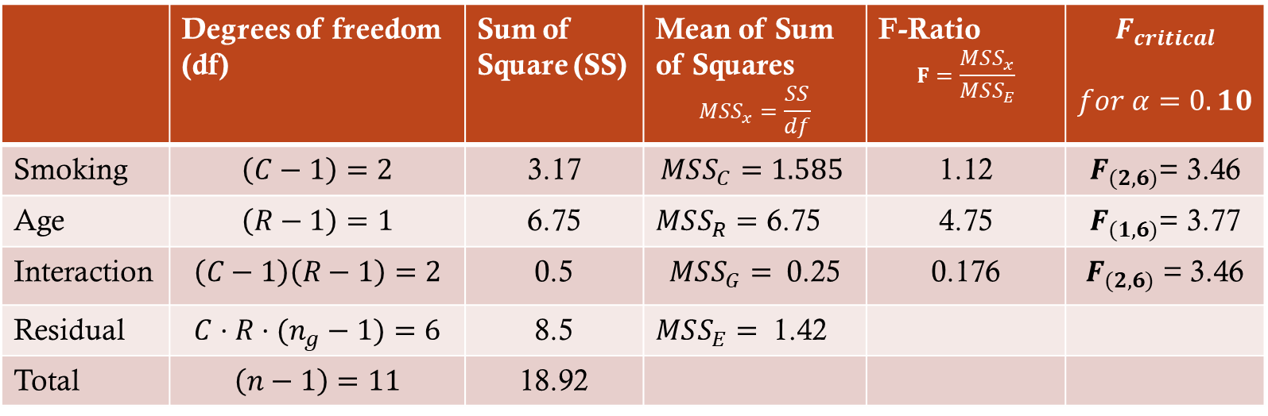
ANOVA (Two-way)
Step 5: Compare with critical value
 | Degrees of freedom (df) | Sum of Square (SS) | Mean of Sum of Squares $$MSS_{x}=\frac{SS}{df}$$ | F-Ratio $$F=\frac{MSS_{x}}{MSS_{E}}$$ | $$F_{critical}$$ $$for α=0.10$$
Smoking | $$\left(C−1\right)=2$$ | 3.17 | $MSS_{C}=1.585$ | 1.12 | $F_{(2,6)}$= 3.46
Age | $$\left(R−1\right)=1$$ | 6.75 | $MSS_{R}=$ 6.75 | 4.75 | $F_{(1,6)}$= 3.77
Interaction | $$\left(C−1\right)\left(R−1\right)=2$$ | 0.5 | $MSS_{G}=$ 0.25 | 0.176 | $F_{(2,6)}$ = 3.46
Residual | $$C⋅R⋅(n_{g}−1)=6$$ | 8.5 | $MSS_{E}=$ 1.42
Total | $$\left(n−1\right)=11$$ | 18.92

Slide 105

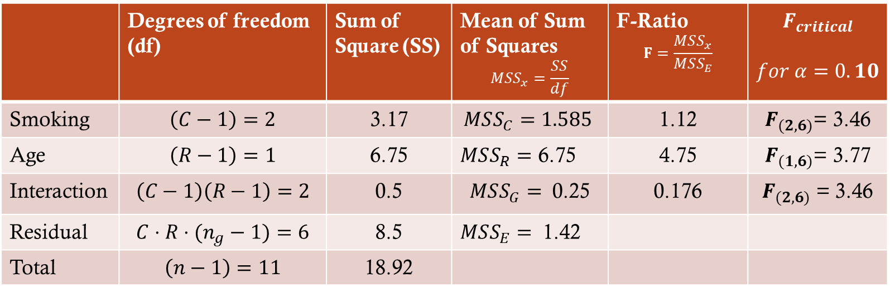

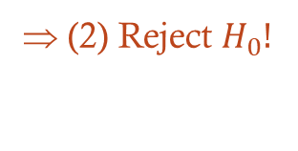
ANOVA (Two-way)
Step 5: Compare with critical value
 | Degrees of freedom (df) | Sum of Square (SS) | Mean of Sum of Squares $$MSS_{x}=\frac{SS}{df}$$ | F-Ratio $$F=\frac{MSS_{x}}{MSS_{E}}$$ | $$F_{critical}$$ $$for α=0.10$$
Smoking | $$\left(C−1\right)=2$$ | 3.17 | $MSS_{C}=1.585$ | 1.12 | $F_{(2,6)}$= 3.46
Age | $$\left(R−1\right)=1$$ | 6.75 | $MSS_{R}=$ 6.75 | 4.75 | $F_{(1,6)}$= 3.77
Interaction | $$\left(C−1\right)\left(R−1\right)=2$$ | 0.5 | $MSS_{G}=$ 0.25 | 0.176 | $F_{(2,6)}$ = 3.46
Residual | $$C⋅R⋅(n_{g}−1)=6$$ | 8.5 | $MSS_{E}=$ 1.42
Total | $$\left(n−1\right)=11$$ | 18.92
(1) Don't reject $H_{0}$
(2) Reject $H_{0}!$
(3) Don't reject $H_{0}$
(1) Smoking does not affect aggressiveness
(2) Age does affect aggressiveness
(3) Different Age groups don't are not affected differently by smoking in terms of aggressiveness

Slide 106
ANOVA (Two-way)
Step 5: Compare with critical value
How we can perform a two-way ANOVA
How we can interpret the result & draw conclusions

Slide 107
ANOVA (Two-way)
Step 1: State the null hypothesis
 | Non-smoker | Weak smoker | Strong smoker | Row Total
Younger | 4 | 5 | 5 | $$R_{1}=32$$
Younger | 5 | 6 | 7
Older | 2 | 3 | 4 | $$R_{1}=23$$
Older | 5 | 4 | 5
Column Total | $C_{1}=$ 16 | $C_{2}=$ 18 | $C_{3}=$21

Slide 108
ANOVA (Two-way)
Step 2: Calculate the means for the combinations
 | Non-smoker | Weak smoker | Strong smoker
Younger | 4 | 5 | 5
Younger | 5 | 6 | 7
Older | 2 | 3 | 4
Older | 5 | 4 | 5
 | Non-smoker | Weak smoker | Strong smoker
Younger | 4.5 | 5.5 | 6
Older | 3.5 | 3.5 | 4.5

Slide 109
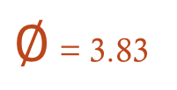
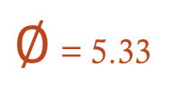
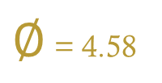
ANOVA (Two-way)
Step 2: Calculate the means for the combinations
 | Non-smoker | Weak smoker | Strong smoker
Younger | 4 | 5 | 5
Younger | 5 | 6 | 7
Older | 2 | 3 | 4
Older | 5 | 4 | 5
 | Non-smoker | Weak smoker | Strong smoker
Younger | 4.5 | 5.5 | 6
Older | 3.5 | 3.5 | 4.5
$∅$ = 5.33
$∅$ = 3.83
$∅$ = 4.58

Slide 110
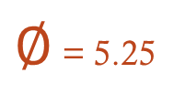
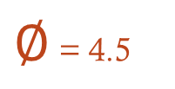
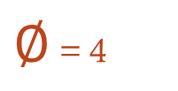
ANOVA (Two-way)
Step 2: Calculate the means for the combinations
 | Non-smoker | Weak smoker | Strong smoker
Younger | 4 | 5 | 5
Younger | 5 | 6 | 7
Older | 2 | 3 | 4
Older | 5 | 4 | 5
 | Non-smoker | Weak smoker | Strong smoker
Younger | 4.5 | 5.5 | 6
Older | 3.5 | 3.5 | 4.5
$∅$ = 5.33
$∅$ = 3.83
$∅$ = 4
$∅$ = 4.5
$∅$ = 5.25
$∅$ = 4.58

Slide 111
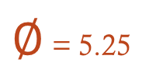

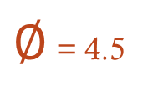
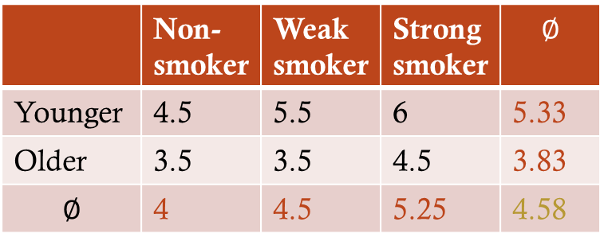
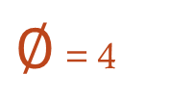

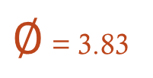
ANOVA (Two-way)
Step 2: Calculate the means for the combinations
 | Non-smoker | Weak smoker | Strong smoker
Younger | 4 | 5 | 5
Younger | 5 | 6 | 7
Older | 2 | 3 | 4
Older | 5 | 4 | 5
 | Non-smoker | Weak smoker | Strong smoker | $$∅$$
Younger | 4.5 | 5.5 | 6 | 5.33
Older | 3.5 | 3.5 | 4.5 | 3.83
$$∅$$ | 4 | 4.5 | 5.25 | 4.58
$∅$ = 5.33
$∅$ = 3.83
$∅$ = 4
$∅$ = 4.5
$∅$ = 5.25
$∅$ = 4.58

Slide 112
ANOVA (Two-way)
Step 2: Calculate the means for the combinations
 | Non-smoker | Weak smoker | Strong smoker
Younger | 4 | 5 | 5
Younger | 5 | 6 | 7
Older | 2 | 3 | 4
Older | 5 | 4 | 5
 | Non-smoker | Weak smoker | Strong smoker | $$∅$$
Younger | 4.5 | 5.5 | 6 | 5.33
Older | 3.5 | 3.5 | 4.5 | 3.83
$$∅$$ | 4 | 4.5 | 5.25 | 4.58

Slide 113
ANOVA (Two-way)
Step 2: Calculate the means for the combinations
 | Non-smoker | Weak smoker | Strong smoker
Younger | 4 | 5 | 5
Younger | 5 | 6 | 7
Older | 2 | 3 | 4
Older | 5 | 4 | 5
 | Non-smoker | Weak smoker | Strong smoker | $$∅$$
Younger | 4.5 | 5.5 | 6 | 5.33
Older | 3.5 | 3.5 | 4.5 | 3.83
$$∅$$ | 4 | 4.5 | 5.25 | 4.58

Slide 114

ANOVA (Two-way)
Step 3: Calculate the sum of squares
 | Non-smoker | Weak smoker | Strong smoker
Younger | 4 | 5 | 5
Younger | 5 | 6 | 7
Older | 2 | 3 | 4
Older | 5 | 4 | 5
 | Non-smoker | Weak smoker | Strong smoker | $$∅$$
Younger | 4.5 | 5.5 | 6 | 5.33
Older | 3.5 | 3.5 | 4.5 | 3.83
$$∅$$ | 4 | 4.5 | 5.25 | 4.58
Sum of squares 1st factor (Smoking)
Sum of squares 2nd factor (Age)
Sum of squares (within) / Error
Sum of squares (Both)
Sum of Squares (Total)

Slide 115
ANOVA (Two-way)
Step 3: Calculate the sum of squares
 | Non-smoker | Weak smoker | Strong smoker
Younger | 4 | 5 | 5
Younger | 5 | 6 | 7
Older | 2 | 3 | 4
Older | 5 | 4 | 5
 | Non-smoker | Weak smoker | Strong smoker | $$∅$$
Younger | 4.5 | 5.5 | 6 | 5.33
Older | 3.5 | 3.5 | 4.5 | 3.83
$$∅$$ | 4 | 4.5 | 5.25 | 4.58
Sum of squares 1st factor (Smoking)
+
Sum of squares 2nd factor (Age)
+
Sum of squares (within) / Error
+
Sum of squares (Both)
Sum of Squares (Total)

Slide 116
ANOVA (Two-way)
Step 2: Calculate the means for the combinations
 | Non-smoker | Weak smoker | Strong smoker
Younger | 4 | 5 | 5
Younger | 5 | 6 | 7
Older | 2 | 3 | 4
Older | 5 | 4 | 5
 | Non-smoker | Weak smoker | Strong smoker | $$∅$$
Younger | 4.5 | 5.5 | 6 | 5.33
Older | 3.5 | 3.5 | 4.5 | 3.83
$$∅$$ | 4 | 4.5 | 5.25 | 4.58
Sum of squares 1st factor (Age)
+
Sum of squares 2nd factor (Smoking)
Sum of Squares (total)
+
Sum of squares (within) / Error
+
Sum of squares (Both)
Sum of Squares (Total)

Slide 117

ANOVA (Two-way)
Step 3: Calculate the sum of squares
 | Non-smoker | Weak smoker | Strong smoker
Younger | 4 | 5 | 5
Younger | 5 | 6 | 7
Older | 2 | 3 | 4
Older | 5 | 4 | 5
 | Non-smoker | Weak smoker | Strong smoker | $$∅$$
Younger | 4.5 | 5.5 | 6 | 5.33
Older | 3.5 | 3.5 | 4.5 | 3.83
$$∅$$ | 4 | 4.5 | 5.25 | 4.58
Sum of squares 1st factor (Age)

Slide 118
ANOVA (Two-way)
Step 3: Calculate the sum of squares
 | Non-smoker | Weak smoker | Strong smoker
Younger | 4 | 5 | 5
Younger | 5 | 6 | 7
Older | 2 | 3 | 4
Older | 5 | 4 | 5
 | Non-smoker | Weak smoker | Strong smoker | $$∅$$
Younger | 4.5 | 5.5 | 6 | 5.33
Older | 3.5 | 3.5 | 4.5 | 3.83
$$∅$$ | 4 | 4.5 | 5.25 | 4.58
Sum of squares 1st factor (Age)
 | Non-smoker | Weak smoker | Strong smoker
Younger | 4 | 5 | 5
Younger | 5 | 6 | 7
 | Non-smoker | Weak smoker | Strong smoker
Older | 2 | 3 | 4
Older | 5 | 4 | 5
∅ 5.33
∅ 4.58
∅ 3.83

Slide 119
ANOVA (Two-way)
Step 3: Calculate the sum of squares
Sum of squares 1st factor (Age)
Younger
4
5
5
6
5
7
∅ 5.33
∅ 4.58
∅ 5.33
∅ 4.58
∅ 5.33
∅ 4.58
∅ 5.33
∅ 4.58
∅ 5.33
∅ 4.58
∅ 5.33
∅ 4.58

Slide 120
ANOVA (Two-way)
Step 3: Calculate the sum of squares
Sum of squares 1st factor (Age)
Younger
4
5
5
6
5
7
Result
(5.33 - 4.58)² = 0.5625
(5.33 - 4.58)² = 0.5625
(5.33 - 4.58)² = 0.5625
(5.33 - 4.58)² = 0.5625
(5.33 - 4.58)² = 0.5625
(5.33 - 4.58)² = 0.5625
∅ 5.33
∅ 4.58
∅ 5.33
∅ 4.58
∅ 5.33
∅ 4.58
∅ 5.33
∅ 4.58
∅ 5.33
∅ 4.58
∅ 5.33
∅ 4.58

Slide 121

ANOVA (Two-way)
Step 3: Calculate the sum of squares
Sum of squares 1st factor (Age)
Younger
4
5
5
6
5
7
Result
(5.33 - 4.58)² = 0.5625
(5.33 - 4.58)² = 0.5625
(5.33 - 4.58)² = 0.5625
(5.33 - 4.58)² = 0.5625
(5.33 - 4.58)² = 0.5625
(5.33 - 4.58)² = 0.5625
∅ 5.33
∅ 4.58
∅ 5.33
∅ 4.58
∅ 5.33
∅ 4.58
∅ 5.33
∅ 4.58
∅ 5.33
∅ 4.58
∅ 5.33
∅ 4.58
$Σ$ = 3.375

Slide 122
ANOVA (Two-way)
Step 3: Calculate the sum of squares
 | Non-smoker | Weak smoker | Strong smoker
Younger | 4 | 5 | 5
Younger | 5 | 6 | 7
Older | 2 | 3 | 4
Older | 5 | 4 | 5
 | Non-smoker | Weak smoker | Strong smoker | $$∅$$
Younger | 4.5 | 5.5 | 6 | 5.33
Older | 3.5 | 3.5 | 4.5 | 3.83
$$∅$$ | 4 | 4.5 | 5.25 | 4.58
Sum of squares 1st factor (Age)
 | Non-smoker | Weak smoker | Strong smoker
Younger | 4 | 5 | 5
Younger | 5 | 6 | 7
 | Non-smoker | Weak smoker | Strong smoker
Older | 2 | 3 | 4
Older | 5 | 4 | 5
∅ 5.33
∅ 4.58
∅ 3.83

Slide 123
ANOVA (Two-way)
Step 3: Calculate the sum of squares
Sum of squares 1st factor (Age)
Older
2
3
4
5
4
5
Result
(3.83 - 4.58)² = 0.5625
(5.33 - 4.58)² = 0.5625
(5.33 - 4.58)² = 0.5625
(5.33 - 4.58)² = 0.5625
(5.33 - 4.58)² = 0.5625
(5.33 - 4.58)² = 0.5625
∅ 3.83
∅ 4.58
∅ 3.83
∅ 4.58
∅ 3.83
∅ 4.58
∅ 3.83
∅ 4.58
∅ 3.83
∅ 4.58
∅ 3.83
∅ 4.58
$Σ$ = 3.375

Slide 124



ANOVA (Two-way)
Step 3: Calculate the sum of squares
Sum of squares 1st factor (Age)
Older
2
3
4
5
4
5
Result
(3.83 - 4.58)² = 0.5625
(5.33 - 4.58)² = 0.5625
(5.33 - 4.58)² = 0.5625
(5.33 - 4.58)² = 0.5625
(5.33 - 4.58)² = 0.5625
(5.33 - 4.58)² = 0.5625
∅ 3.83
∅ 4.58
∅ 3.83
∅ 4.58
∅ 3.83
∅ 4.58
∅ 3.83
∅ 4.58
∅ 3.83
∅ 4.58
∅ 3.83
∅ 4.58
$Σ$ = 3.375
$$+$$
$Σ$ = 3.375
= 6.75
Sum of squares 1st factor (Age)

Slide 125
ANOVA (Two-way)
Step 3: Calculate the sum of squares
6.75
Sum of squares 1st factor (Age)
+
Sum of squares 2nd factor (Smoking)
Sum of Squares (total)
+
Sum of squares (within) / Error
+
Sum of squares (Both)
Sum of Squares (Total)

Slide 126

ANOVA (Two-way)
Step 3: Calculate the sum of squares
Sum of squares 2nd factor (Smoking)
 | Non-smoker | Weak smoker | Strong smoker
Younger | 4 | 5 | 5
Younger | 5 | 6 | 7
Older | 2 | 3 | 4
Older | 5 | 4 | 5
 | Non-smoker | Weak smoker | Strong smoker | $$∅$$
Younger | 4.5 | 5.5 | 6 | 5.33
Older | 3.5 | 3.5 | 4.5 | 3.83
$$∅$$ | 4 | 4.5 | 5.25 | 4.58
∅ 4
∅ 4.5
∅ 5.25
∅ 4.58
 | Non-smoker | Weak smoker | Strong smoker
Younger | 4 | 5 | 5
Younger | 5 | 6 | 7
 | Non-smoker | Weak smoker | Strong smoker
Older | 2 | 3 | 4
Older | 5 | 4 | 5

Slide 127
ANOVA (Two-way)
Step 3: Calculate the sum of squares
Sum of squares 2nd factor (Smoking)
 | Non-smoker | Weak smoker | Strong smoker
Younger | 4 | 5 | 5
Younger | 5 | 6 | 7
Older | 2 | 3 | 4
Older | 5 | 4 | 5
 | Non-smoker | Weak smoker | Strong smoker | $$∅$$
Younger | 4.5 | 5.5 | 6 | 5.33
Older | 3.5 | 3.5 | 4.5 | 3.83
$$∅$$ | 4 | 4.5 | 5.25 | 4.58
∅ 4
∅ 4.5
∅ 5.25
∅ 4.58
Non-smoker
4
5
2
5
Weak smoker
5
6
3
4
Strong smoker
5
7
4
5

Slide 128
ANOVA (Two-way)
Step 3: Calculate the sum of squares
Sum of squares 2nd factor (Smoking)
 | Non-smoker | Weak smoker | Strong smoker
Younger | 4 | 5 | 5
Younger | 5 | 6 | 7
Older | 2 | 3 | 4
Older | 5 | 4 | 5
 | Non-smoker | Weak smoker | Strong smoker | $$∅$$
Younger | 4.5 | 5.5 | 6 | 5.33
Older | 3.5 | 3.5 | 4.5 | 3.83
$$∅$$ | 4 | 4.5 | 5.25 | 4.58
Non-smoker
4
5
2
5
Weak smoker
5
6
3
4
Strong smoker
5
7
4
5
∅ 4
∅ 4.58
∅ 4.5
∅ 4.58
∅ 5.25
∅ 4.58

Slide 129
ANOVA (Two-way)
Step 3: Calculate the sum of squares
Sum of squares 2nd factor (Smoking)
 | Non-smoker | Weak smoker | Strong smoker
Younger | 4 | 5 | 5
Younger | 5 | 6 | 7
Older | 2 | 3 | 4
Older | 5 | 4 | 5
 | Non-smoker | Weak smoker | Strong smoker | $$∅$$
Younger | 4.5 | 5.5 | 6 | 5.33
Older | 3.5 | 3.5 | 4.5 | 3.83
$$∅$$ | 4 | 4.5 | 5.25 | 4.58
Non-smoker
4
5
2
5
Weak smoker
5
6
3
4
Strong smoker
5
7
4
5
∅ 4
∅ 4.58
∅ 4.5
∅ 4.58
∅ 5.25
∅ 4.58
∅ 4
∅ 4.58
∅ 4.5
∅ 4.58
∅ 5.25
∅ 4.58
∅ 4
∅ 4.58
∅ 4.5
∅ 4.58
∅ 5.25
∅ 4.58
∅ 4
∅ 4.58
∅ 4.5
∅ 4.58
∅ 5.25
∅ 4.58

Slide 130
ANOVA (Two-way)
Step 3: Calculate the sum of squares
Sum of squares 2nd factor (Smoking)
 | Non-smoker | Weak smoker | Strong smoker
Younger | 4 | 5 | 5
Younger | 5 | 6 | 7
Older | 2 | 3 | 4
Older | 5 | 4 | 5
 | Non-smoker | Weak smoker | Strong smoker | $$∅$$
Younger | 4.5 | 5.5 | 6 | 5.33
Older | 3.5 | 3.5 | 4.5 | 3.83
$$∅$$ | 4 | 4.5 | 5.25 | 4.58
Non-smoker
4
5
2
5
Weak smoker
5
6
3
4
Strong smoker
5
7
4
5
(4 – 4.58)² =0.3364
(4 – 4.58)² =0.3364
(4 – 4.58)² =0.3364
(4 – 4.58)² =0.3364
∅ 4
∅ 4.58
∅ 4.5
∅ 4.58
∅ 5.25
∅ 4.58
∅ 4
∅ 4.58
∅ 4.5
∅ 4.58
∅ 5.25
∅ 4.58
∅ 4
∅ 4.58
∅ 4.5
∅ 4.58
∅ 5.25
∅ 4.58
∅ 4
∅ 4.58
∅ 4.5
∅ 4.58
∅ 5.25
∅ 4.58

Slide 131
ANOVA (Two-way)
Step 3: Calculate the sum of squares
Sum of squares 2nd factor (Smoking)
 | Non-smoker | Weak smoker | Strong smoker
Younger | 4 | 5 | 5
Younger | 5 | 6 | 7
Older | 2 | 3 | 4
Older | 5 | 4 | 5
 | Non-smoker | Weak smoker | Strong smoker | $$∅$$
Younger | 4.5 | 5.5 | 6 | 5.33
Older | 3.5 | 3.5 | 4.5 | 3.83
$$∅$$ | 4 | 4.5 | 5.25 | 4.58
Non-smokers
(4 – 4.58)² =0.3364
(4 – 4.58)² =0.3364
(4 – 4.58)² =0.3364
(4 – 4.58)² =0.3364
Weak smoker
( 4.5 – 4.58)² = 0.0064
( 4.5 – 4.58)² = 0.0064
( 4.5 – 4.58)² = 0.0064
( 4.5 – 4.58)² = 0.0064
Strong smoker
(5.25-4.58)² = 0.4489
(5.25-4.58)² = 0.4489
(5.25-4.58)² = 0.4489
(5.25-4.58)² = 0.4489
∅ 4.5
∅ 4.58
∅ 5.25
∅ 4.58
∅ 4.5
∅ 4.58
∅ 5.25
∅ 4.58
∅ 4.5
∅ 4.58
∅ 5.25
∅ 4.58
∅ 4.5
∅ 4.58
∅ 5.25
∅ 4.58

Slide 132



ANOVA (Two-way)
Step 3: Calculate the sum of squares
Sum of squares 2nd factor (Smoking)
Non-smokers
(4 – 4.58)² =0.3364
(4 – 4.58)² =0.3364
(4 – 4.58)² =0.3364
(4 – 4.58)² =0.3364
Weak smoker
( 4.5 – 4.58)² = 0.0064
( 4.5 – 4.58)² = 0.0064
( 4.5 – 4.58)² = 0.0064
( 4.5 – 4.58)² = 0.0064
Strong smoker
(5.25-4.58)² = 0.4489
(5.25-4.58)² = 0.4489
(5.25-4.58)² = 0.4489
(5.25-4.58)² = 0.4489
4 $⋅$ 0.3364 = 1.3456
4 $⋅$ 0.0064 = 0.0256
4 $⋅$ 0.4489 = 1.7956

Slide 133

ANOVA (Two-way)
Step 3: Calculate the sum of squares
Sum of squares 2nd factor (Smoking)
Non-smokers
(4 – 4.58)² =0.3364
(4 – 4.58)² =0.3364
(4 – 4.58)² =0.3364
(4 – 4.58)² =0.3364
Weak smoker
( 4.5 – 4.58)² = 0.0064
( 4.5 – 4.58)² = 0.0064
( 4.5 – 4.58)² = 0.0064
( 4.5 – 4.58)² = 0.0064
Strong smoker
(5.25-4.58)² = 0.4489
(5.25-4.58)² = 0.4489
(5.25-4.58)² = 0.4489
(5.25-4.58)² = 0.4489
4 $⋅$ 0.3364 = 1.3456
4 $⋅$ 0.0064 = 0.0256
4 $⋅$ 0.4489 = 1.7956
$Σ$=3.1668

Slide 134
ANOVA (Two-way)
Step 3: Calculate the sum of squares
6.75
Sum of squares 1st factor (Age)
3.1668
+
Sum of squares 2nd factor (Smoking)
Sum of Squares (total)
+
Sum of squares (within) / Error
+
Sum of squares (Both)
Sum of Squares (Total)

Slide 135
ANOVA (Two-way)
Step 3: Calculate the sum of squares
Sum of squares (within) / Error
 | Non-smoker | Weak smoker | Strong smoker
Younger | 4 | 5 | 5
Younger | 5 | 6 | 7
Older | 2 | 3 | 4
Older | 5 | 4 | 5
 | Non-smoker | Weak smoker | Strong smoker | $$∅$$
Younger | 4.5 | 5.5 | 6 | 5.33
Older | 3.5 | 3.5 | 4.5 | 3.83
$$∅$$ | 4 | 4.5 | 5.25 | 4.58

Slide 136
ANOVA (Two-way)
Step 3: Calculate the sum of squares
Sum of squares (within) / Error
Younger
4
5
5
6
5
7
 | Non-smoker | Weak smoker | Strong smoker | $$∅$$
Younger | 4.5 | 5.5 | 6 | 5.33
Older | 3.5 | 3.5 | 4.5 | 3.83
$$∅$$ | 4 | 4.5 | 5.25 | 4.58
 | Non-smoker | Weak smoker | Strong smoker
Younger | 4 | 5 | 5
Younger | 5 | 6 | 7
Older | 2 | 3 | 4
Older | 5 | 4 | 5

Slide 137
ANOVA (Two-way)
Step 3: Calculate the sum of squares
Sum of squares (within) / Error
Younger
4
5
5
6
5
7
 | Non-smoker | Weak smoker | Strong smoker | $$∅$$
Younger | 4.5 | 5.5 | 6 | 5.33
Older | 3.5 | 3.5 | 4.5 | 3.83
$$∅$$ | 4 | 4.5 | 5.25 | 4.58
∅ 4
∅ 4.5
∅ 5.25
 | Non-smoker | Weak smoker | Strong smoker
Younger | 4 | 5 | 5
Younger | 5 | 6 | 7
Older | 2 | 3 | 4
Older | 5 | 4 | 5

Slide 138
ANOVA (Two-way)
Step 3: Calculate the sum of squares
Sum of squares (within) / Error
Younger
4
5
5
6
5
7
 | Non-smoker | Weak smoker | Strong smoker | $$∅$$
Younger | 4.5 | 5.5 | 6 | 5.33
Older | 3.5 | 3.5 | 4.5 | 3.83
$$∅$$ | 4 | 4.5 | 5.25 | 4.58
∅ 4
∅ 4.5
∅ 5.25
 | Non-smoker | Weak smoker | Strong smoker
Younger | 4 | 5 | 5
Younger | 5 | 6 | 7
Older | 2 | 3 | 4
Older | 5 | 4 | 5

Slide 139

ANOVA (Two-way)
Step 3: Calculate the sum of squares
Sum of squares (within) / Error
Younger
4
5
5
6
5
7
Younger
(4 – 4)² = 0
(5 – 4)² = 1
(5 – 4.5)² = 0.25
(6 – 4.5)² = 2.25
(5 – 5.25)² = 0.0625
(7 – 5.25)² = 3.0625
 | Non-smoker | Weak smoker | Strong smoker | $$∅$$
Younger | 4.5 | 5.5 | 6 | 5.33
Older | 3.5 | 3.5 | 4.5 | 3.83
$$∅$$ | 4 | 4.5 | 5.25 | 4.58
∅ 4
∅ 4
∅ 4.5
∅ 4.5
∅ 5.25
∅ 5.25
 | Non-smoker | Weak smoker | Strong smoker
Younger | 4 | 5 | 5
Younger | 5 | 6 | 7
Older | 2 | 3 | 4
Older | 5 | 4 | 5

Slide 140

ANOVA (Two-way)
Step 3: Calculate the sum of squares
Sum of squares (within) / Error
Younger
(4 – 4)² = 0
(5 – 4)² = 1
(5 – 4.5)² = 0.25
(6 – 4.5)² = 2.25
(5 – 5.25)² = 0.0625
(7 – 5.25)² = 3.0625
Older
(2 – 4)² = 4
(5 – 4)² = 1
(3 – 4.5)² = 2.25
(4 – 4.5)² = 0.25
(4 – 5.25)² = 1.5625
(5 – 5.25)² = 0.0625
 | Non-smoker | Weak smoker | Strong smoker | $$∅$$
Younger | 4.5 | 5.5 | 6 | 5.33
Older | 3.5 | 3.5 | 4.5 | 3.83
$$∅$$ | 4 | 4.5 | 5.25 | 4.58
∅ 4
∅ 4
∅ 4.5
∅ 4.5
∅ 5.25
 | Non-smoker | Weak smoker | Strong smoker
Younger | 4 | 5 | 5
Younger | 5 | 6 | 7
Older | 2 | 3 | 4
Older | 5 | 4 | 5
∅ 5.25

Slide 141


ANOVA (Two-way)
Step 3: Calculate the sum of squares
Sum of squares (within) / Error
Younger
(4 – 4)² = 0
(5 – 4)² = 1
(5 – 4.5)² = 0.25
(6 – 4.5)² = 2.25
(5 – 5.25)² = 0.0625
(7 – 5.25)² = 3.0625
Older
(2 – 4)² = 4
(5 – 4)² = 1
(3 – 4.5)² = 2.25
(4 – 4.5)² = 0.25
(4 – 5.25)² = 1.5625
(5 – 5.25)² = 0.0625
 | Non-smoker | Weak smoker | Strong smoker | $$∅$$
Younger | 4.5 | 5.5 | 6 | 5.33
Older | 3.5 | 3.5 | 4.5 | 3.83
$$∅$$ | 4 | 4.5 | 5.25 | 4.58
∅ 4
∅ 4
∅ 4.5
∅ 4.5
∅ 5.25
 | Non-smoker | Weak smoker | Strong smoker
Younger | 4 | 5 | 5
Younger | 5 | 6 | 7
Older | 2 | 3 | 4
Older | 5 | 4 | 5
∅ 5.25
$Σ$=6.625
$Σ$=9.125

Slide 142



ANOVA (Two-way)
Step 3: Calculate the sum of squares
Sum of squares (within) / Error
Younger
(4 – 4)² = 0
(5 – 4)² = 1
(5 – 4.5)² = 0.25
(6 – 4.5)² = 2.25
(5 – 5.25)² = 0.0625
(7 – 5.25)² = 3.0625
Older
(2 – 4)² = 4
(5 – 4)² = 1
(3 – 4.5)² = 2.25
(4 – 4.5)² = 0.25
(4 – 5.25)² = 1.5625
(5 – 5.25)² = 0.0625
 | Non-smoker | Weak smoker | Strong smoker | $$∅$$
Younger | 4.5 | 5.5 | 6 | 5.33
Older | 3.5 | 3.5 | 4.5 | 3.83
$$∅$$ | 4 | 4.5 | 5.25 | 4.58
∅ 4
∅ 4
∅ 4.5
∅ 4.5
∅ 5.25
 | Non-smoker | Weak smoker | Strong smoker
Younger | 4 | 5 | 5
Younger | 5 | 6 | 7
Older | 2 | 3 | 4
Older | 5 | 4 | 5
∅ 5.25
$Σ$=6.625
$Σ$=9.125
$Σ$=15.75

Slide 143
ANOVA (Two-way)
Step 3: Calculate the sum of squares
6.75
Sum of squares 1st factor (Age)
3.1668
+
Sum of squares 2nd factor (Smoking)
Sum of Squares (total)
15.75
+
Sum of squares (within) / Error
+
Sum of squares (Both)
Sum of Squares (Total)

Slide 144
ANOVA (Two-way)
Step 3: Calculate the sum of squares
 | Non-smoker | Weak smoker | Strong smoker
Younger | 4 | 5 | 5
Younger | 5 | 6 | 7
Older | 2 | 3 | 4
Older | 5 | 4 | 5
 | Non-smoker | Weak smoker | Strong smoker | $$∅$$
Younger | 4.5 | 5.5 | 6 | 5.33
Older | 3.5 | 3.5 | 4.5 | 3.83
$$∅$$ | 4 | 4.5 | 5.25 | 4.58

Slide 145
ANOVA (Two-way)
Step 3: Calculate the sum of squares
4
5
2
5
5
6
3
4
5
7
4
5
Average
4.58
4.58
4.58
4.58
4.58
4.58
4.58
4.58
4.58
4.58
4.58
4.58
 | Non-smoker | Weak smoker | Strong smoker | $$∅$$
Younger | 4.5 | 5.5 | 6 | 5.33
Older | 3.5 | 3.5 | 4.5 | 3.83
$$∅$$ | 4 | 4.5 | 5.25 | 4.58
 | Non-smoker | Weak smoker | Strong smoker
Younger | 4 | 5 | 5
Younger | 5 | 6 | 7
Older | 2 | 3 | 4
Older | 5 | 4 | 5

Slide 146

ANOVA (Two-way)
Step 3: Calculate the sum of squares
4
5
2
5
5
6
3
4
5
7
4
5
Average
4.58
4.58
4.58
4.58
4.58
4.58
4.58
4.58
4.58
4.58
4.58
4.58
Sum of squares
(4 - 4.58)² = 0.3364
(5 - 4.58)² = 0.1764
(2- 4.58)² = 6.6564
(5 - 4.58)² = 0.1764
(5 - 4.58)² = 0.1764
(6 - 4.58)² = 2.0164
(3 - 4.58)² = 2.4964
(4 - 4.58)² = 0.3364
(5 - 4.58)² = 0.1764
(7 - 4.58)² = 5.8564
(4 - 4.58)² = 0.3364
(5 - 4.58)² = 0.1764
 | Non-smoker | Weak smoker | Strong smoker | $$∅$$
Younger | 4.5 | 5.5 | 6 | 5.33
Older | 3.5 | 3.5 | 4.5 | 3.83
$$∅$$ | 4 | 4.5 | 5.25 | 4.58
 | Non-smoker | Weak smoker | Strong smoker
Younger | 4 | 5 | 5
Younger | 5 | 6 | 7
Older | 2 | 3 | 4
Older | 5 | 4 | 5

Slide 147

ANOVA (Two-way)
Step 3: Calculate the sum of squares
Sum of squares
(4 - 4.58)² = 0.3364
(5 - 4.58)² = 0.1764
(2- 4.58)² = 6.6564
(5 - 4.58)² = 0.1764
(5 - 4.58)² = 0.1764
(6 - 4.58)² = 2.0164
(3 - 4.58)² = 2.4964
(4 - 4.58)² = 0.3364
(5 - 4.58)² = 0.1764
(7 - 4.58)² = 5.8564
(4 - 4.58)² = 0.3364
(5 - 4.58)² = 0.1764
 | Non-smoker | Weak smoker | Strong smoker | $$∅$$
Younger | 4.5 | 5.5 | 6 | 5.33
Older | 3.5 | 3.5 | 4.5 | 3.83
$$∅$$ | 4 | 4.5 | 5.25 | 4.58
$Σ$=18.9168
 | Non-smoker | Weak smoker | Strong smoker
Younger | 4 | 5 | 5
Younger | 5 | 6 | 7
Older | 2 | 3 | 4
Older | 5 | 4 | 5

Slide 148
ANOVA (Two-way)
Step 3: Calculate the sum of squares
6.75
Sum of squares 1st factor (Age)
3.1668
+
Sum of squares 2nd factor (Smoking)
Sum of Squares (total)
14.75
+
Sum of squares (within) / Error
+
Sum of squares (Both)
18.9168
Sum of Squares (Total)

Slide 149
ANOVA (Two-way)
Step 3: Calculate the sum of squares
Sum of squares 1st factor (Age)
Sum of squares 2nd factor (Smoking)
18.9168
-
6.75
-
14.75
-
3.1668
=
Sum of squares (Both)
Sum of Squares (Total)
Sum of squares (within) / Error

Slide 150
ANOVA (One-way problem)
dfdf

Slide 151
ANOVA (Two-way)

Slide 152
ANOVA (Two-way)
We have two factors (e.g. smoking AND age groups)

Slide 153
ANOVA (Two-way)
 | Non-smoker | Weak smoker | Strong smoker
Younger | 4 | 5 | 5
Younger | 5 | 6 | 7
Older | 2 | 3 | 4
Older | 5 | 4 | 5

